Slide 1
Classroom learning dynamics using a cellular automata spatiotemporal model comparing peer instruction and traditional instruction
Undergraduate Thesis Defense
National Institute of Physics
December 12, 2024, 10:30 AM
Clarence Ioakim T. Sy
BS Applied Physics
Instrumentation Physics Laboratory
National Institute of Physics
University of the Philippines Diliman
Adviser: Johnrob Y. Bantang, Ph.D.

Slide 2
Abstract
Peer instruction (PI) has recently become one of the popular means of classroom instruction in Physics Education. Such instruction method is vastly different from how classes are traditionally handled where the instructor conducts a lecture for the entire duration of the class. In this study, we model the transfer of knowledge within the class as a probabilistic cellular automata model and investigate the effects of different factors such as seating arrangements, size, learning rate, and heterogeneity on the classes’ overall learning efficiency in peer instruction. We compared the learning efficiency between the traditional learning model and the PI model. We found that larger class sizes sway the advantage towards traditional instruction, while increased learning rate heterogeneity favors PI. Additionally, an increase in the students’ effective learning rate benefits both traditional instruction and PI but in different ways. Classes under traditional instruction were found to have two stages of learning when heterogeneity was introduced: a fast initial stage and a slow final stage. On the other hand, learning trends in PI were generally unaffected by heterogeneity, having similar effects with the other factors we considered. Among the seating arrangements (SAs) we considered for PI, the inner corner SA performed the best in terms of both the time it takes for all the students to learn and the classroom’s learning rate. This result differs from previous studies where they found that the outer corner SA performed the best. The difference stems from the simplifications made in this model. We did not consider the orientation factor of each student, resulting in an isotropic system. Our model also uses binary values and does not consider the effect of aptitude similarity that have been described in previous studies. Despite these simplifications, our findings generally agree with previous studies and existing practices that PI performs similarly or better than traditional instruction and that a mix of traditional instruction and PI would be the optimal method of instruction. We offer insights based on the qualitative results of the model.

Slide 3
Outline
Methods of instruction
Homogenous classes
Heterogenous classes
Summary and conclusions
Comparison with other research

Slide 4
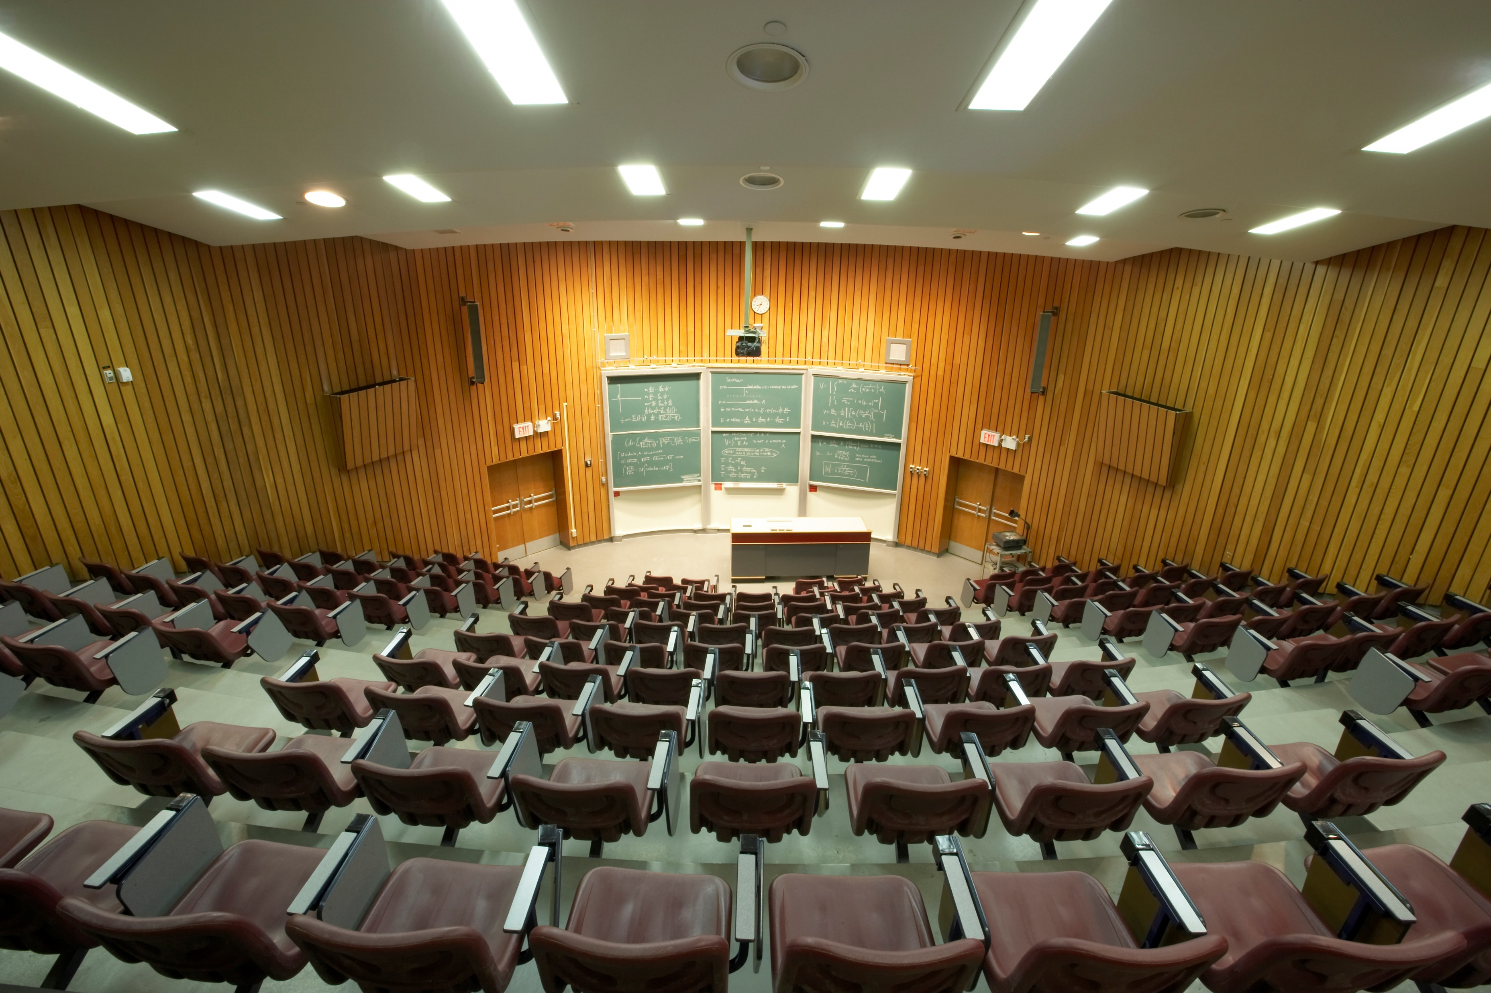
Notes:
Over the years, learning in the academe has always been largely associated with the classroom. From chalk and talk to powerpoint presentations. But how do we really learn in the classroom?

Slide 5


Traditional instruction vs peer instruction
Traditional instruction | Peer instruction
The instructor delivers a lecture to the whole class for the duration of the class time. | Advanced reading Short lecture Concept test (pre-test) Peer discussion Concept test (post-test)
Notes:
Among many methods of instruction, we want to focus on two.
First is traditional instruction where the instructor delivers a lecture to the entire class for the entirety of the class time.
Second is peer instruction. Although there are many ways to employ peer instruction in the classroom, one of the most famous methods is for the instructor to deliver a short lecture, expecting students to have read up on the material beforehand, to be followed by a concept test. From here students are given the opportunity to discuss their answers and learn from each other. After peer discussion, the instructor gives a similar concept test to gauge whether the students know the topic enough before moving on.
From this, one might think that peer instruction sounds much more elaborate than traditional instruction, so why should we bother doing it?

Slide 6
Advantages of peer instruction (PI)
Better test scores
Higher for conceptual and quantitative problems
Fewer students scored extremely low
Students can learn even in naïve groups
Lack of background knowledge does not negatively impact PI
Reduced dropping rates
Crouch and Mazur, 2001; Lasry et. al., 2008; Thacker et. al. 1994
Smith et. al., 2009
Lasry et. al., 2008; Coletta and Phillips, 2005
Lasry et. al., 2008; Tobias, 1990
Notes:
Well, peer instruction has proven to yield higher test scores. More students scored higher for both conceptual and problem-solving problems, and less students scored extremely low scores.
Research has also shown that students can learn even when nobody in their peer discussion group knew the answer to the concept test, dismissing the notion that peer instruction is purely transmissionist. This goes hand-in-hand with a lack of background knowledge not negatively impacting the effectiveness of peer instruction.
Having a student centered method of instruction also reduced student attrition, meaning less students dropped their courses.
Surely a method of instruction that has all these benefits is worth digging deeper into.
Details left unwritten:
Students did good in isomorphic questions
Some learned better when no one in the group knew the answer bec they were forced to engage with the material
PI is not transmissionist

Slide 7

Existing mathematical models for PI
Differential equations (Pritchard, 2008)
No spatial component
Ising model (Bordogna and Albano, 2001 & 2003)
Difficult to incorporate different agent-agent interactions
Neural networks (Roxas, et. al., 2010)
Predictive
Relies on real data or an objective function
Notes:
And people have!
Nitta et al in 2001 have devised differential equations to model learning in the classroom for peer instruction. However, differential equations fail to take into account spatial effects and dynamics that might affect the system
There have also been works that modelled learning in the classroom as an Ising model – something very familiar with us physicist. However, using the ising model makes it hard to dictate how agents interact with each other in the model.
Neural networks and machine learning has proven very useful nowadays – it’s usefulness has also extended in similar works such as with the work of Dr. Roxas-Villanueva and her colleagues in 2010 where there were able to use a convolutional neural network to model and predict how a class under peer instruction would perform, even taking into account factors such as seating arrangements. The drawbacks of using models like these though, are it’s hard to peer into the underlying dynamics of the system even if we’re able to predict what’s going to happen. It also often relies on real-world data or an objective function to give the best results which are often hard to obtain here in the Philippines.
I would like to propose an alternative to all these existing mathematical models for PI, but before we can choose a model, we have to first establish what we want to investigate.

Slide 8
Research questions
How does the number of learned students develop over time?
Spatial position of high aptitude students in class
How does the positioning of learned students affect the learning rate of the class for peer instruction?
Learning rate
Advantages of methods of instruction
When is peer instruction better than traditional instruction?
Which factors lead to a difference in performance?
Notes:
First, I want to find out how learning develops in the classroom over time
Second, I want to find out when peer instruction performs better than traditional instruction and what factors can sway the advantage
Last, I want to find out how different seating arrangements can affect peer instruction

Slide 9


Binary state probabilistic CA model
The classroom is set to be a 2D square grid of varying lengths.
Students are either learned or not learned (state: 0 or 1) with varying individual learning rates.
The simulation is considered done when all students are learned.
The classroom is updated based on PCA rules to simulate the learning process
Notes:
We chose to use the probabilistic cellular automata model to simulate our classroom.
To do this, we set up a 2D square grid with varying lengths to simulate different classroom sizes.
Our agents, or students in this case, can be of two states – learned or not learned. Each student is also assign an individual learning rate.
To simulate the learning process, we update the state of the students based on set PCA rules that describe the interactions that we want to consider.
Finally, we consider the simulation to be done when all students are learned.

Slide 10
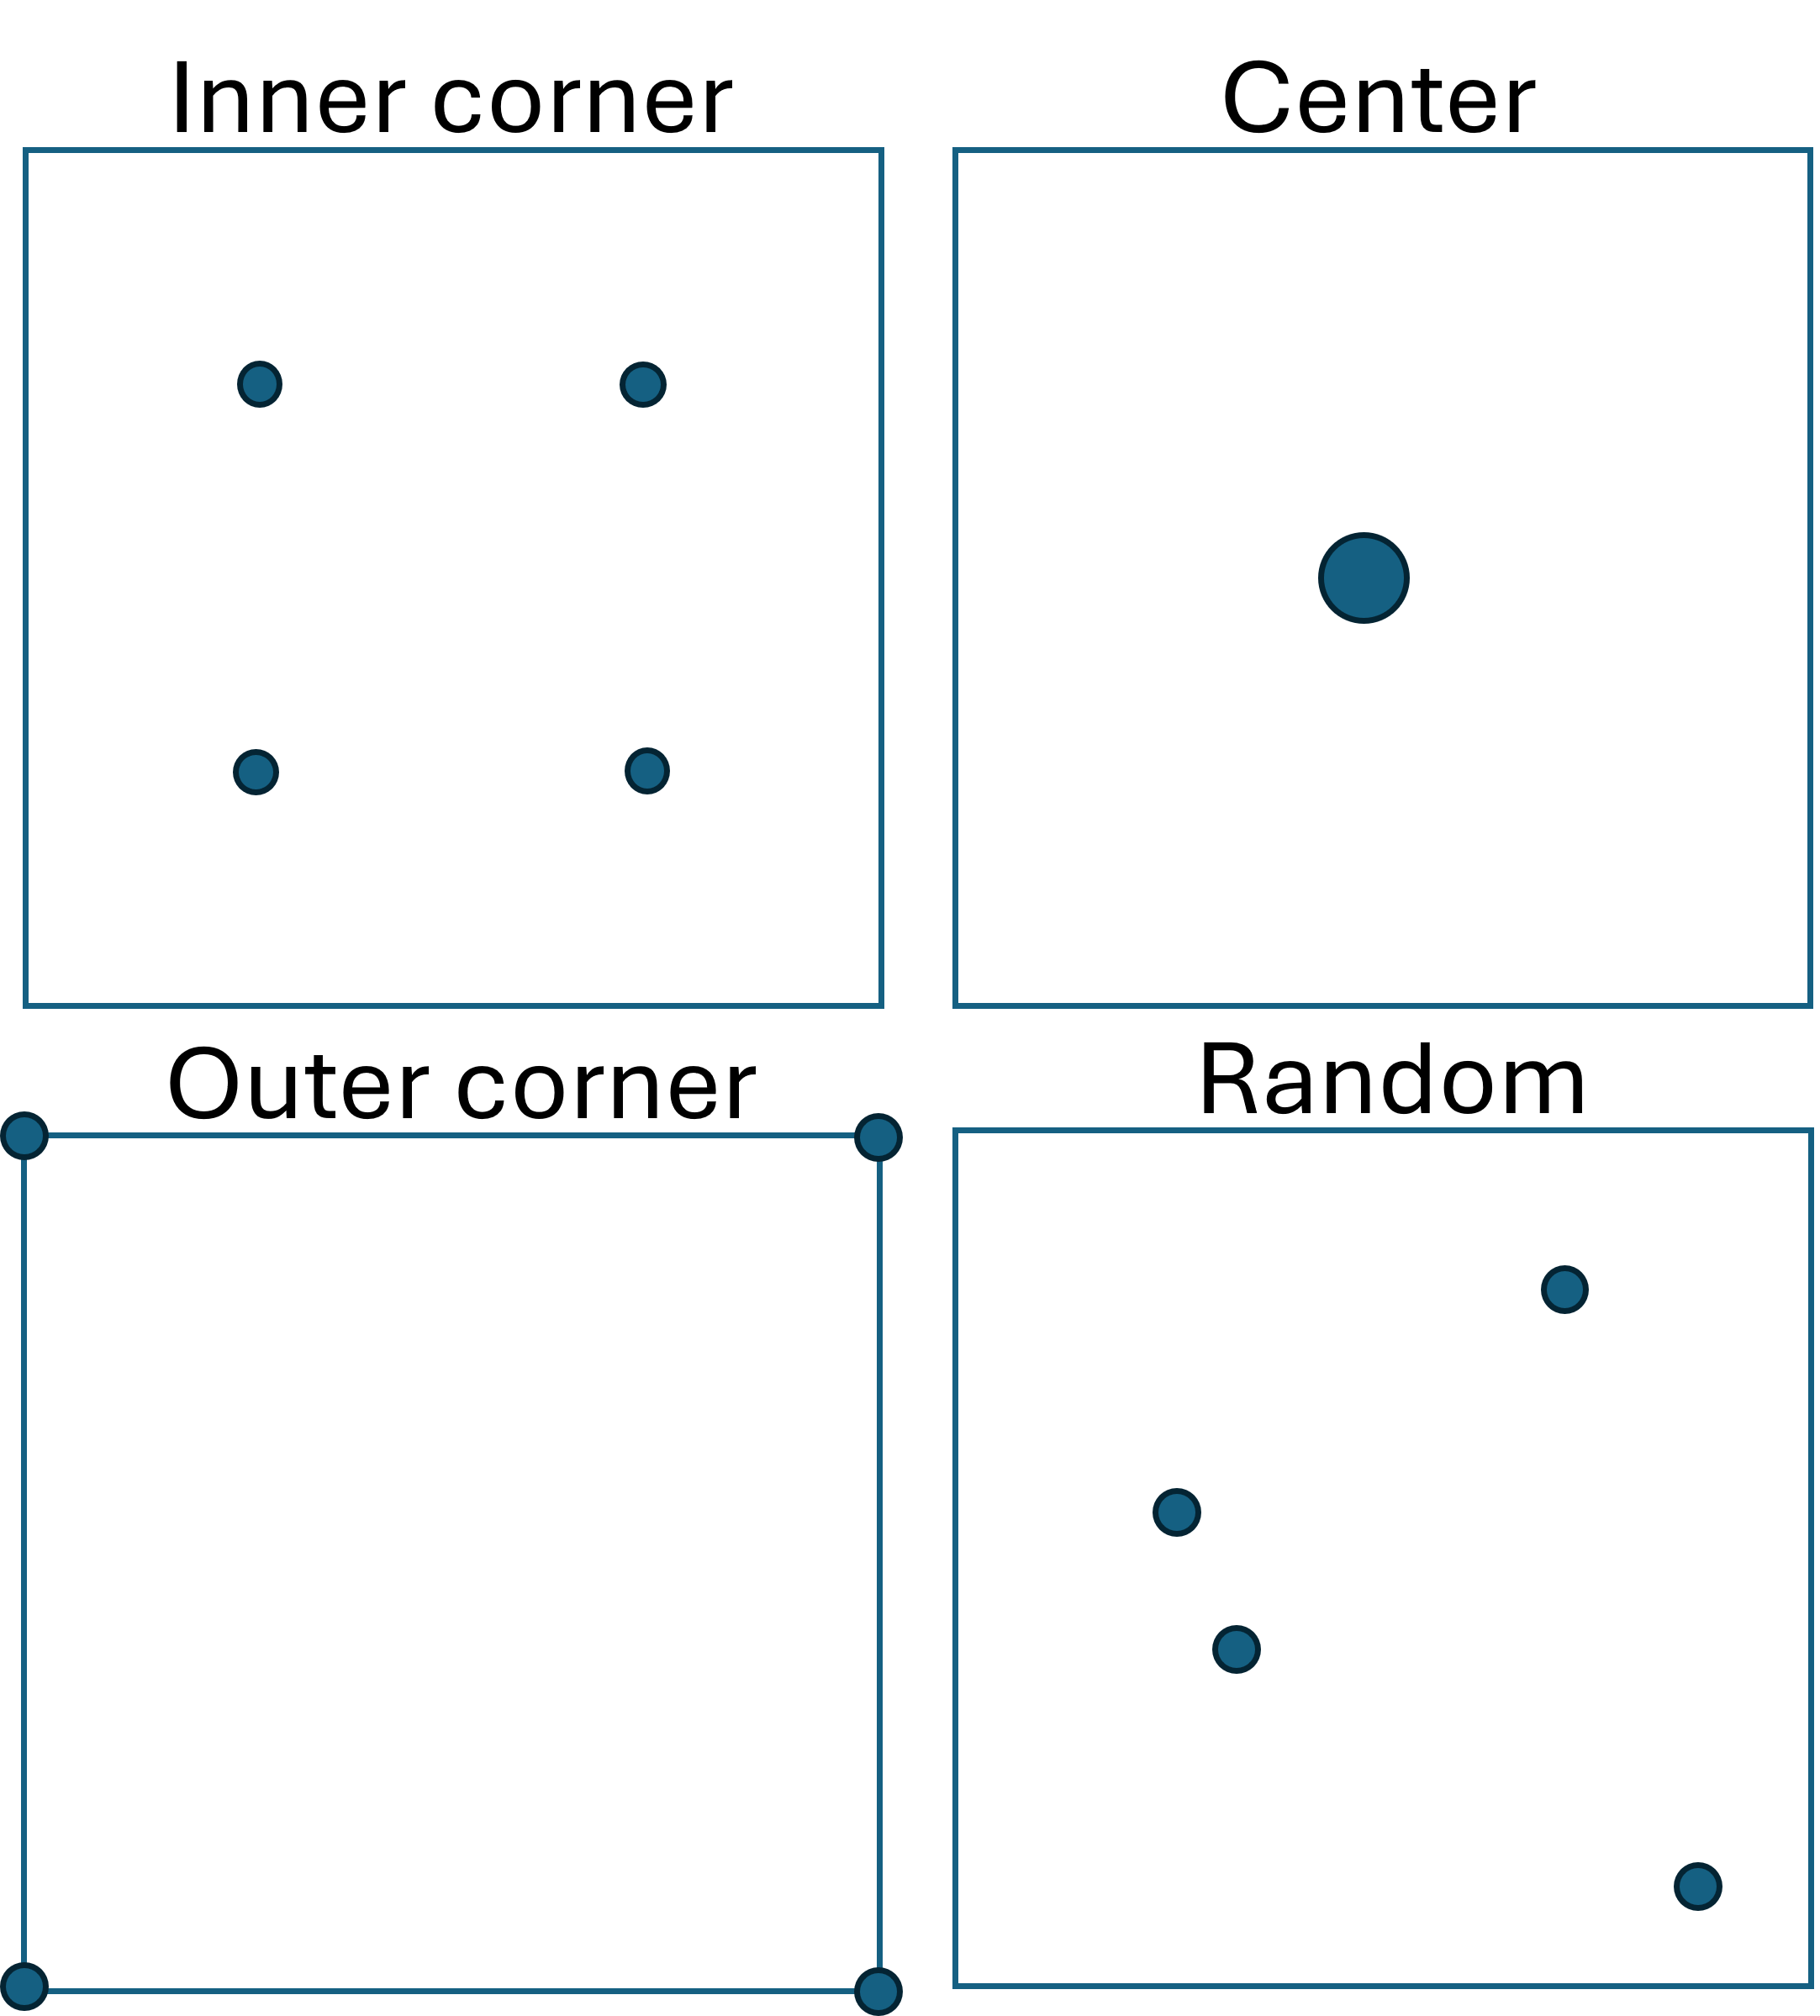
Different initial conditions for PI
- Location of learned students
Notes:
For peer instruction, we set different seating arrangements which describe where the initially learned students are positioned in the classroom. These seating arrangements are the same as those considered in Dr. Roxas-Villanueva’s paper in 2010. This slide gives a visual representation of the learned students’ positions at the start of each simulation.
After getting the initial conditions all set up, we then move on to describing how students can actually learn in the classroom.

Slide 11

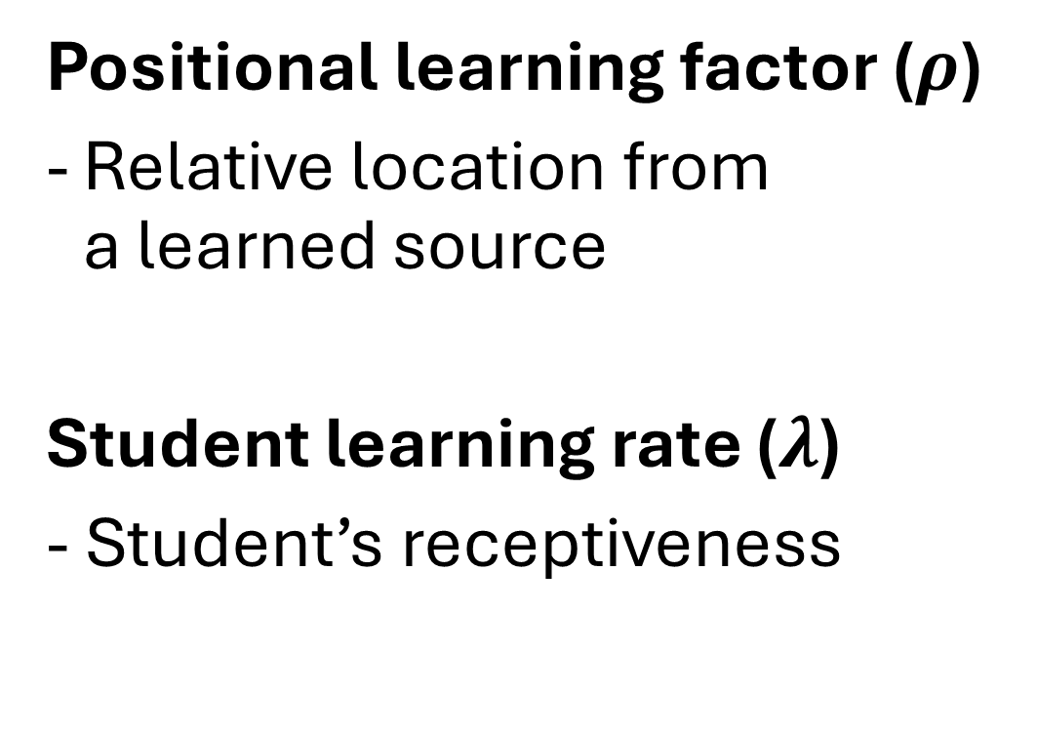
Factors affecting student learning
Positional learning factor ($ρ$)
Relative location from a learned source
Student learning rate ($λ$)
- Student’s receptiveness
Notes:
For our model to reflect the reality of the classroom learning experience, we introduce two parameters that affect student learning.
First is the positional learning factor $ρ_{0}$, which describes how easy it is for a student to learn based on their relative position from a learned source. For traditional instruction, this allows us to model the students seated in front of the class to learn faster than those at the back. In peer instruction, we can make it so that the students can learn from their seatmates easier than from someone who is seated behind them.
To consider that each student has a unique rate of learning, we also introduce student learning rate $λ$, which is assigned to each student and describes how fast that students learn in general.

Slide 12
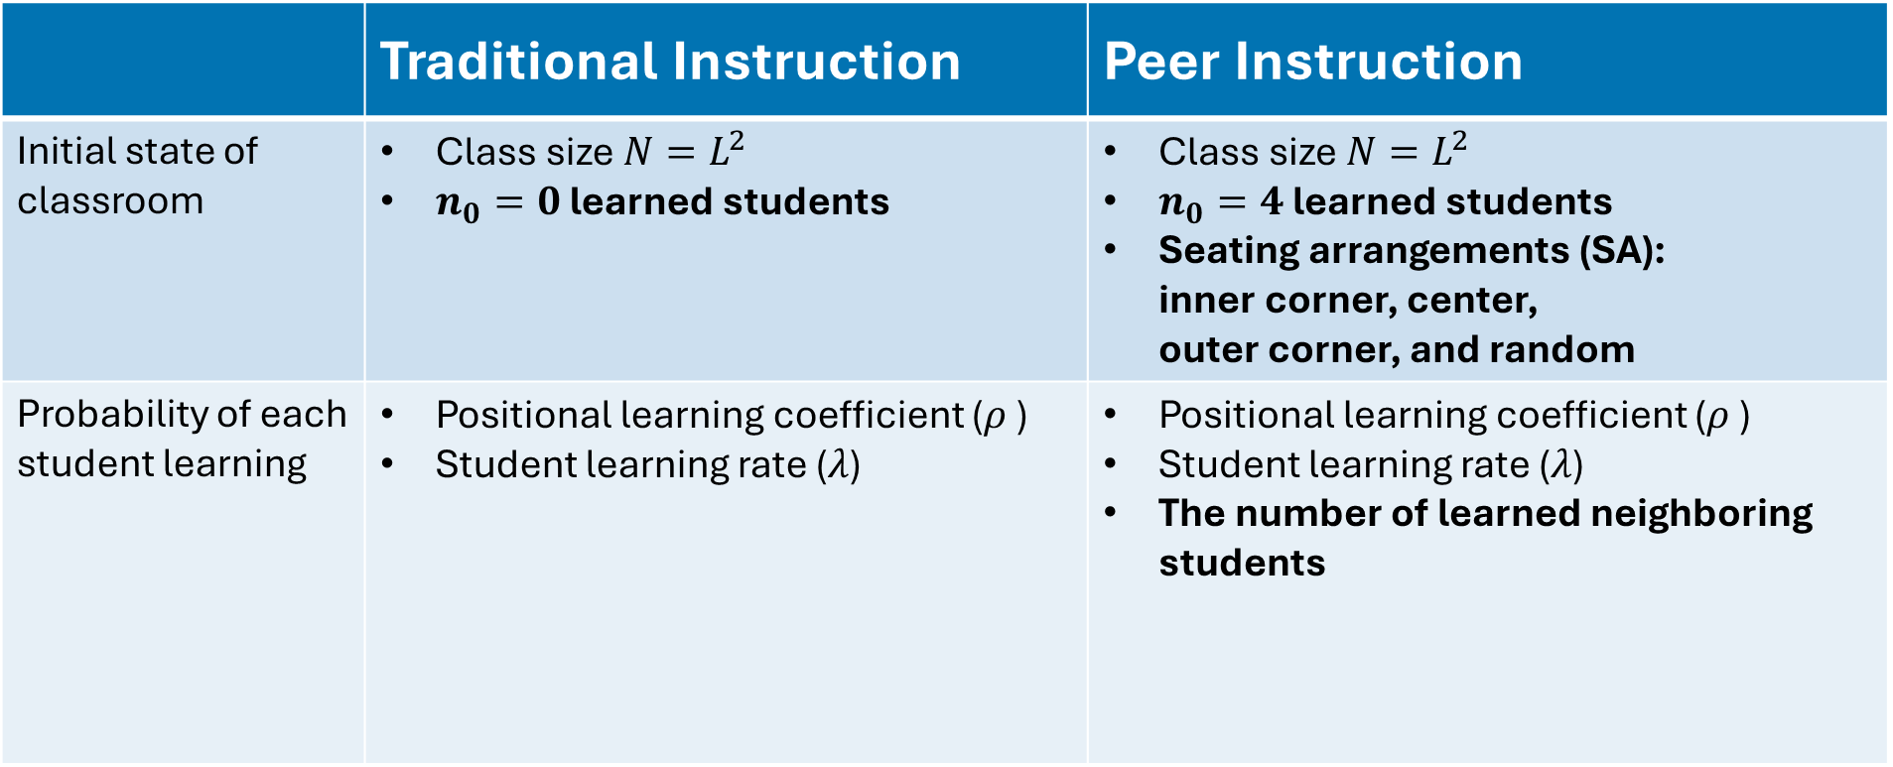
Summary of input parameters
 | Traditional Instruction | Peer Instruction
Initial state of classroom | Class size $N=L^{2}$ $n_{0}=0$ learned students | Class size $N=L^{2}$ $n_{0}=4$ learned students Seating arrangements (SA): inner corner, center, outer corner, and random
Probability of each student learning | Positional learning coefficient ($ρ$ ) Student learning rate ($λ$) | Positional learning coefficient ($ρ$ ) Student learning rate ($λ$) The number of learned neighboring students
Notes:
This table summarizes all of the input parameters we’ve discussed so far and highlights the differences between our models for traditional instruction and peer instruction.
Traditional instruction starts with 0 learned students, while peer instruction starts with 4. These 4 learned students are then placed in the classroom in accordance to the chosen seating arrangements
In addition to $ρ_{0}$ and $λ_{0}$, we also want to factor in the number of learned neighbors in peer instruction when calculating the students’ probability to learn

Slide 13
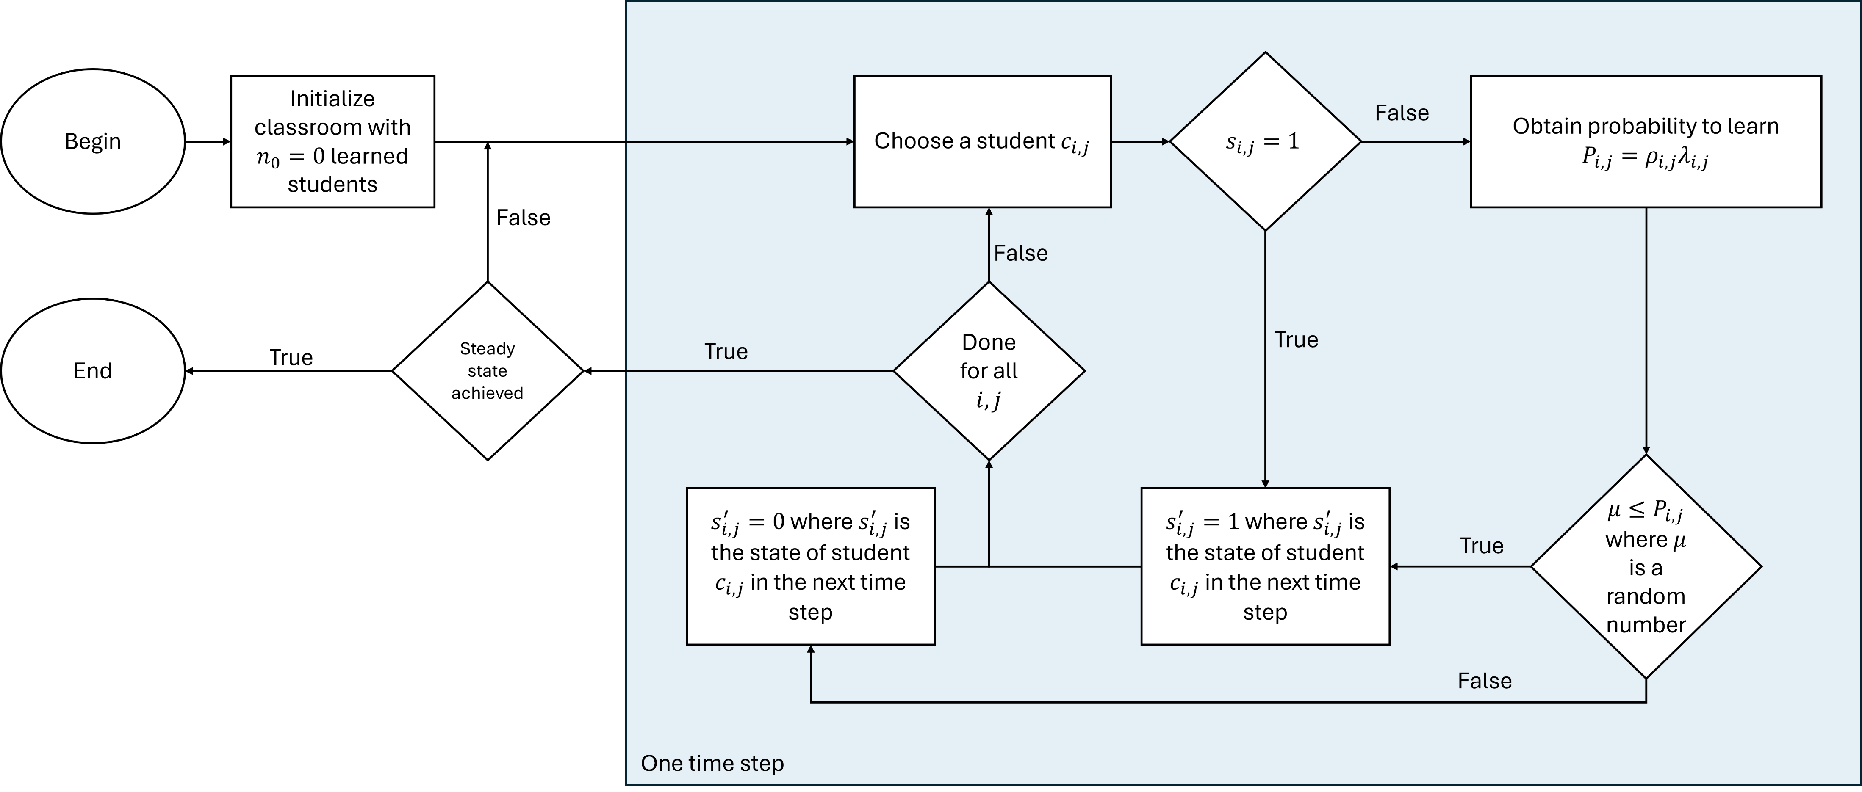
Flowchart for traditional instruction
Notes:
This flowchart better visualizes how our model works for traditional instruction. Starting from 0 learned students, we loop through each student in one time step, obtaining their probability to learn based on their $ρ_{0}$ and $λ_{0}$ and generating a random number to decide whether the student learns or not. We repeat this process until the classroom reaches a steady state

Slide 14
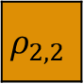
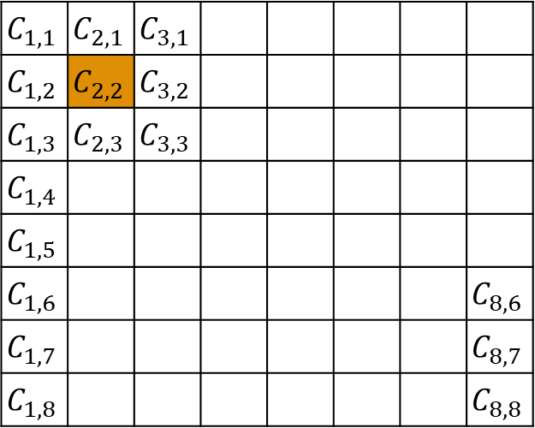
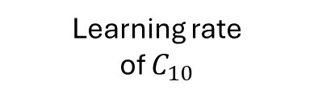

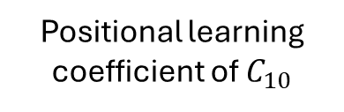

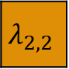
PCA model overview for traditional instruction
$$C_{1,1}$$ | $$C_{2,1}$$ | $$C_{3,1}$$
$$C_{1,2}$$ | $$C_{2,2}$$ | $$C_{3,2}$$
$$C_{1,3}$$ | $$C_{2,3}$$ | $$C_{3,3}$$
$$C_{1,4}$$
$$C_{1,5}$$
$$C_{1,6}$$ |  |  |  |  |  |  | $$C_{8,6}$$
$$C_{1,7}$$ |  |  |  |  |  |  | $$C_{8,7}$$
$$C_{1,8}$$ |  |  |  |  |  |  | $$C_{8,8}$$
$$ρ_{2,2}$$
$$⊙$$
$$λ_{2,2}$$
Positional learning coefficient of $C_{10}$
Learning rate of $C_{10}$
$$P_{ij}=ρ_{i,j}λ_{i,j}$$
Learning probability:
Classroom represented as lattice of cells
Notes:
To better visualize this process in the context of the classroom or grid we have this overview. Here we see that for traditional instruction, our $ρ$ and $λ$ values are intrinsic to the student.

Slide 15
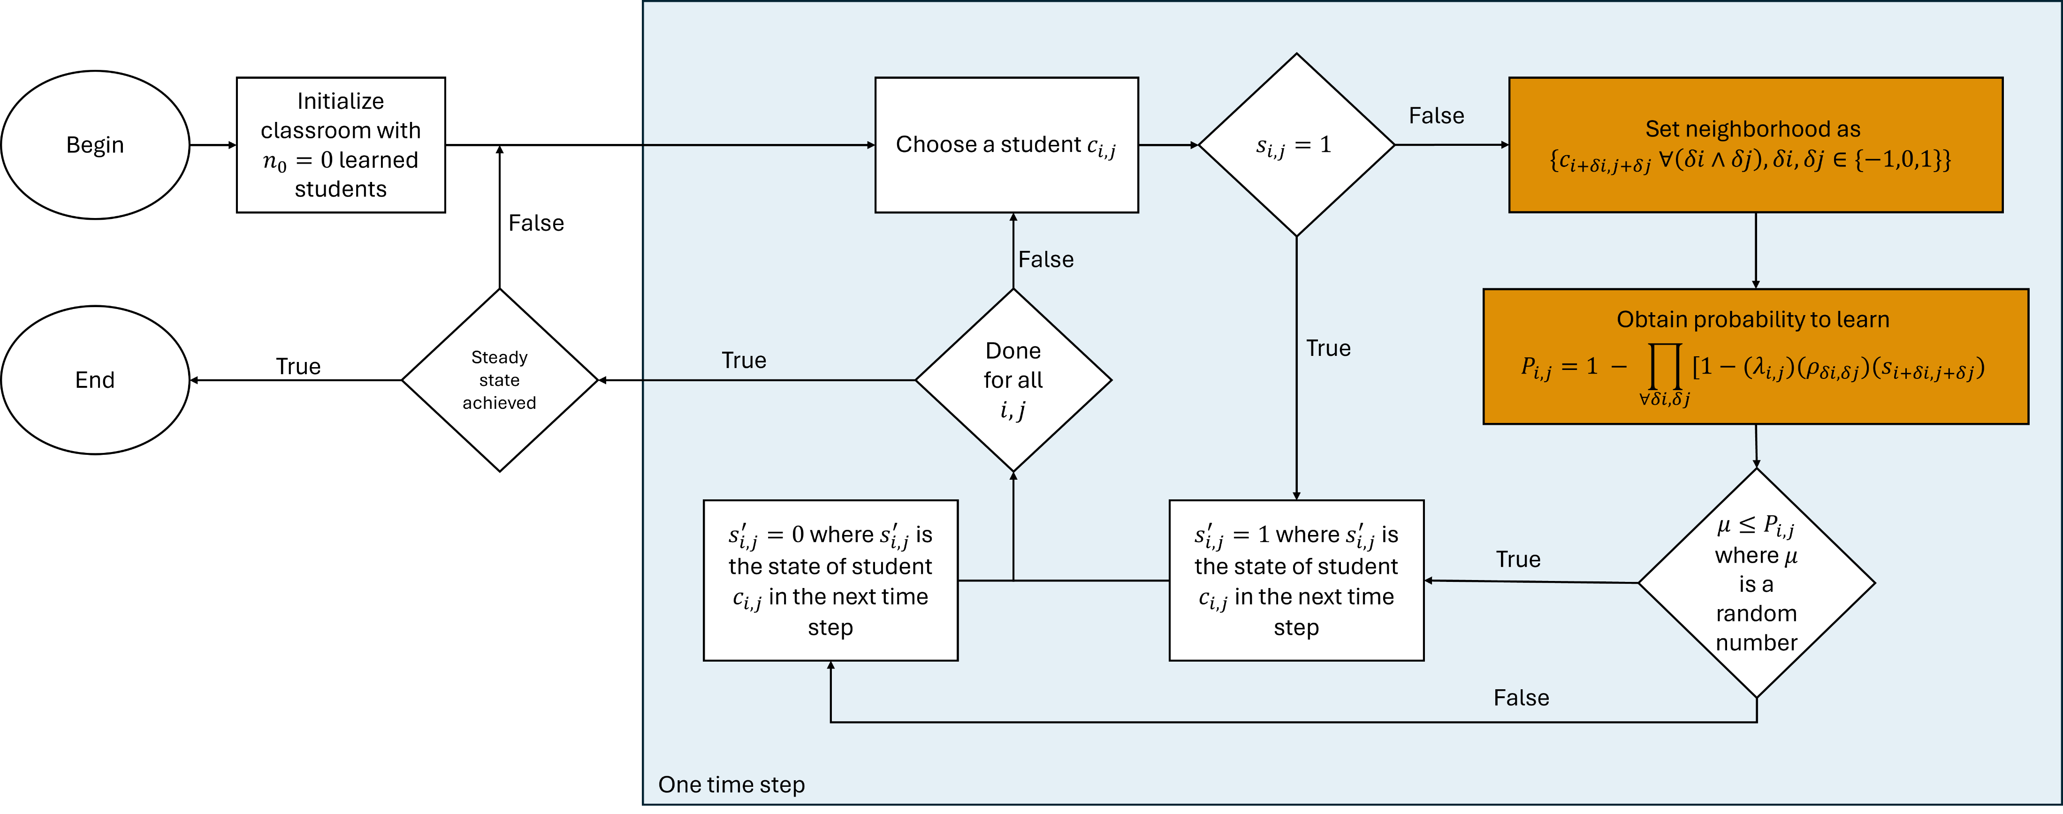
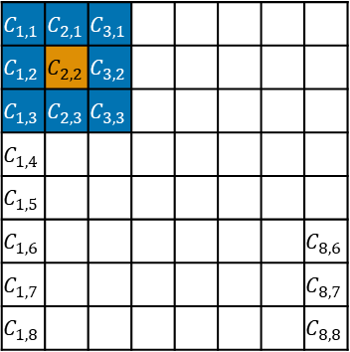
Flowchart for PI
$$C_{1,1}$$ | $$C_{2,1}$$ | $$C_{3,1}$$
$$C_{1,2}$$ | $$C_{2,2}$$ | $$C_{3,2}$$
$$C_{1,3}$$ | $$C_{2,3}$$ | $$C_{3,3}$$
$$C_{1,4}$$
$$C_{1,5}$$
$$C_{1,6}$$ |  |  |  |  |  |  | $$C_{8,6}$$
$$C_{1,7}$$ |  |  |  |  |  |  | $$C_{8,7}$$
$$C_{1,8}$$ |  |  |  |  |  |  | $$C_{8,8}$$
Notes:
This is different from our process in modelling peer instruction where we also consider the neighborhood of each student to obtain their probability to learn.

Slide 16
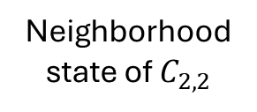
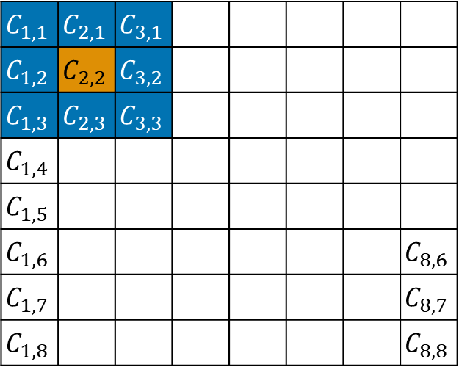

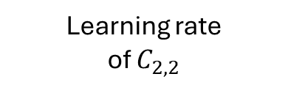
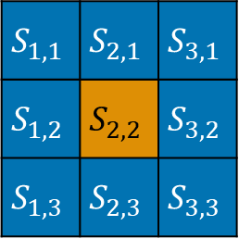

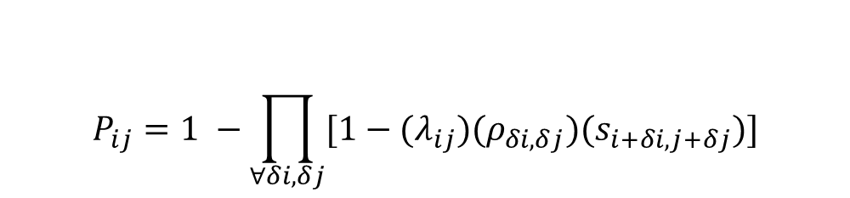
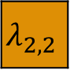
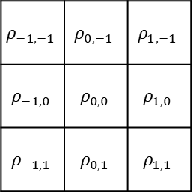
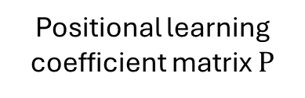
PCA model overview for PI
$$S_{1,1}$$ | $$S_{2,1}$$ | $$S_{3,1}$$
$$S_{1,2}$$ | $$S_{2,2}$$ | $$S_{3,2}$$
$$S_{1,3}$$ | $$S_{2,3}$$ | $$S_{3,3}$$
$$ρ_{−1,−1}$$ | $$ρ_{0,−1}$$ | $$ρ_{1,−1}$$
$$ρ_{−1,0}$$ | $$ρ_{0,0}$$ | $$ρ_{1,0}$$
$$ρ_{−1,1}$$ | $$ρ_{0,1}$$ | $$ρ_{1,1}$$
$$C_{1,1}$$ | $$C_{2,1}$$ | $$C_{3,1}$$
$$C_{1,2}$$ | $$C_{2,2}$$ | $$C_{3,2}$$
$$C_{1,3}$$ | $$C_{2,3}$$ | $$C_{3,3}$$
$$C_{1,4}$$
$$C_{1,5}$$
$$C_{1,6}$$ |  |  |  |  |  |  | $$C_{8,6}$$
$$C_{1,7}$$ |  |  |  |  |  |  | $$C_{8,7}$$
$$C_{1,8}$$ |  |  |  |  |  |  | $$C_{8,8}$$
$$⊙$$
$$⊙$$
$$λ_{2,2}$$
Neighborhood state of $C_{2,2}$
Positional learning coefficient matrix $Ρ$
Learning rate of $C_{2,2}$
$$P_{ij}=1 −\prod_{∀δi,δj}{[1−{(λ}_{ij})(ρ_{δi, δj})(s_{i+δi, j+δj})]}$$
Learning probability:
Classroom represented as lattice of cells
Notes:
In considering the neighbors, we also have to take into account the positional learning coefficient matrix which is a representation of how likely it is for a student to learn from their seatmates. If, for example, we want to model a system where the one student learns better from those seated beside them compared to those seated behind them, then we’d find higher values for $ρ_{2}$ and $ρ_{8}$ than $ρ_{6}$.
In this example where we want to find the student 10’s probability of learning in one time step, we take the state of its neighbors and multiply element-wise with our chosen values of $ρ$ in the matrix, each being modified by student 10’s learning rate. This gives us the values of the second term in the product operator.

Slide 17
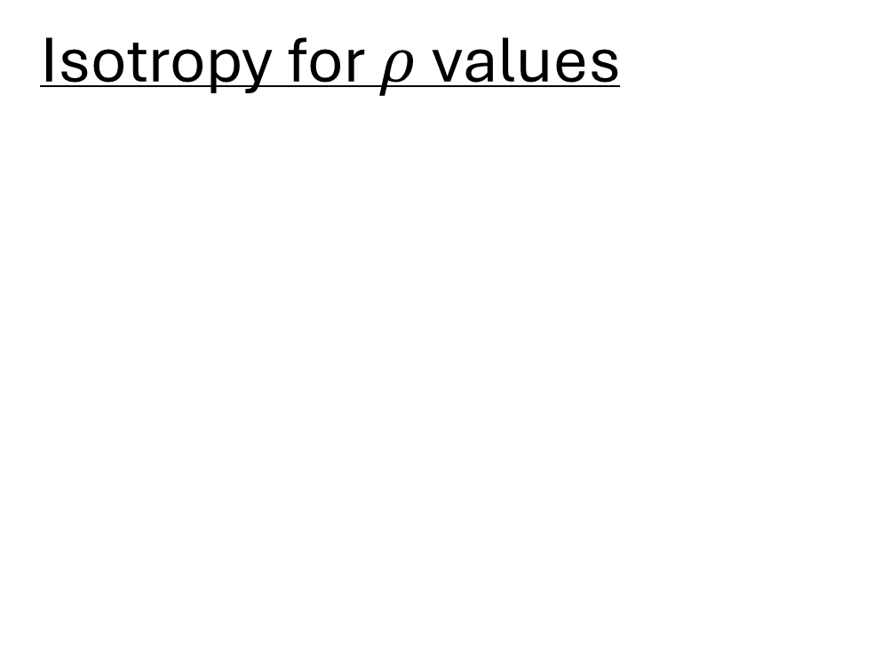
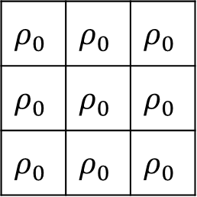
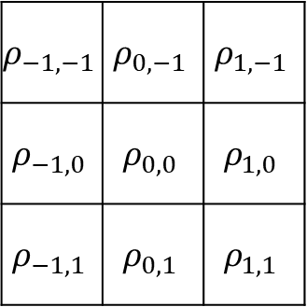
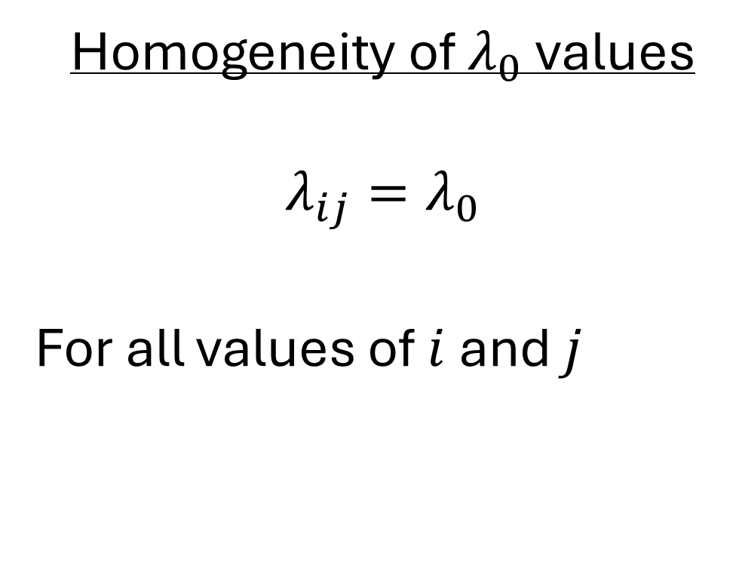
Model assumption
Isotropy for $ρ$values
Homogeneity of $λ_{0}$ values
$$λ_{ij}=λ_{0}$$
For all values of $i$ and $j$
$$ρ_{−1,−1}$$ | $$ρ_{0,−1}$$ | $$ρ_{1,−1}$$
$$ρ_{−1,0}$$ | $$ρ_{0,0}$$ | $$ρ_{1,0}$$
$$ρ_{−1,1}$$ | $$ρ_{0,1}$$ | $$ρ_{1,1}$$
$$ρ_{0}$$ | $$ρ_{0}$$ | $$ρ_{0}$$
$$ρ_{0}$$ | $$ρ_{0}$$ | $$ρ_{0}$$
$$ρ_{0}$$ | $$ρ_{0}$$ | $$ρ_{0}$$
Notes:
To start with, we made two assumptions.
First, that learning is isotropic, meaning that each student has equal chances to learn from each of their neighbors
Second, is that all students have the same learning rate.

Slide 18



Sample progression of states
$$t=0$$
$$t=1$$
$$t=2$$
Previously learned students
Newly learned students
Notes:
After describing how the processes happen, this is an example of how learning might progress in the classroom.

Slide 19
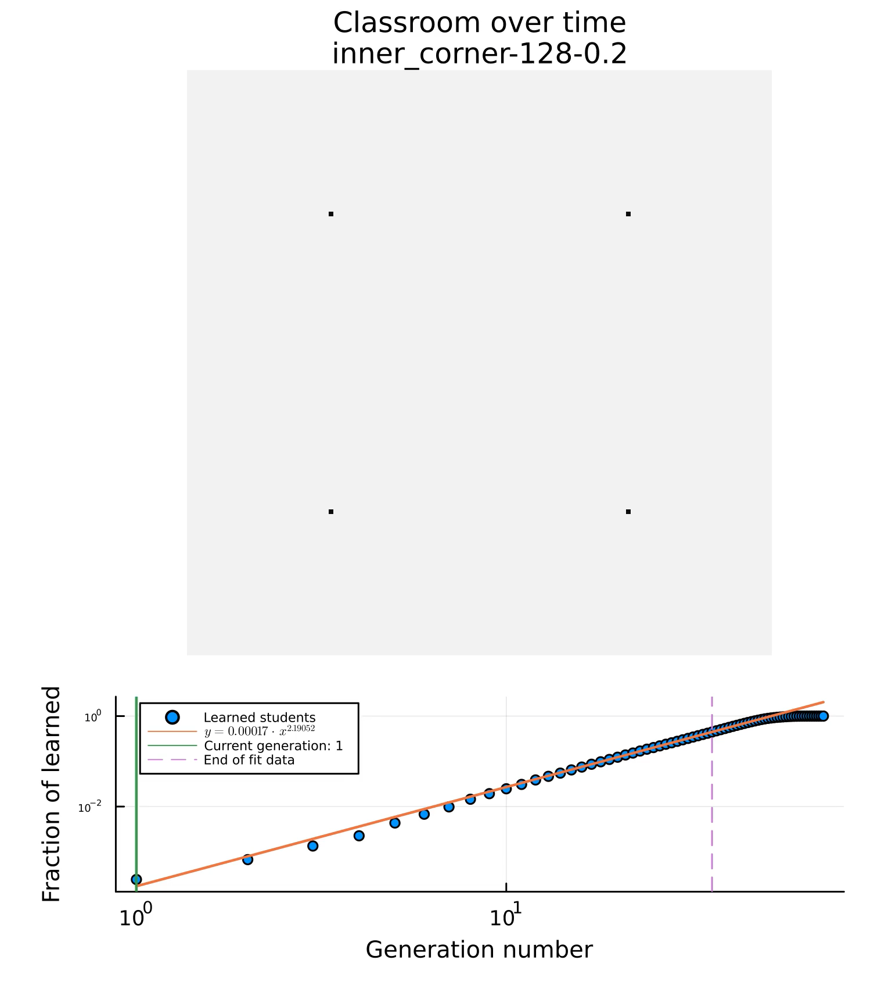
Sample progression of states continued
$$L=128, ρ_{0}=0.2, λ_{0}=1$$
Current time step:
Notes:
Repeating that processes several times gives us something like this. However, we used two different PCA rules for traditional instruction and peer instruction.

Slide 20
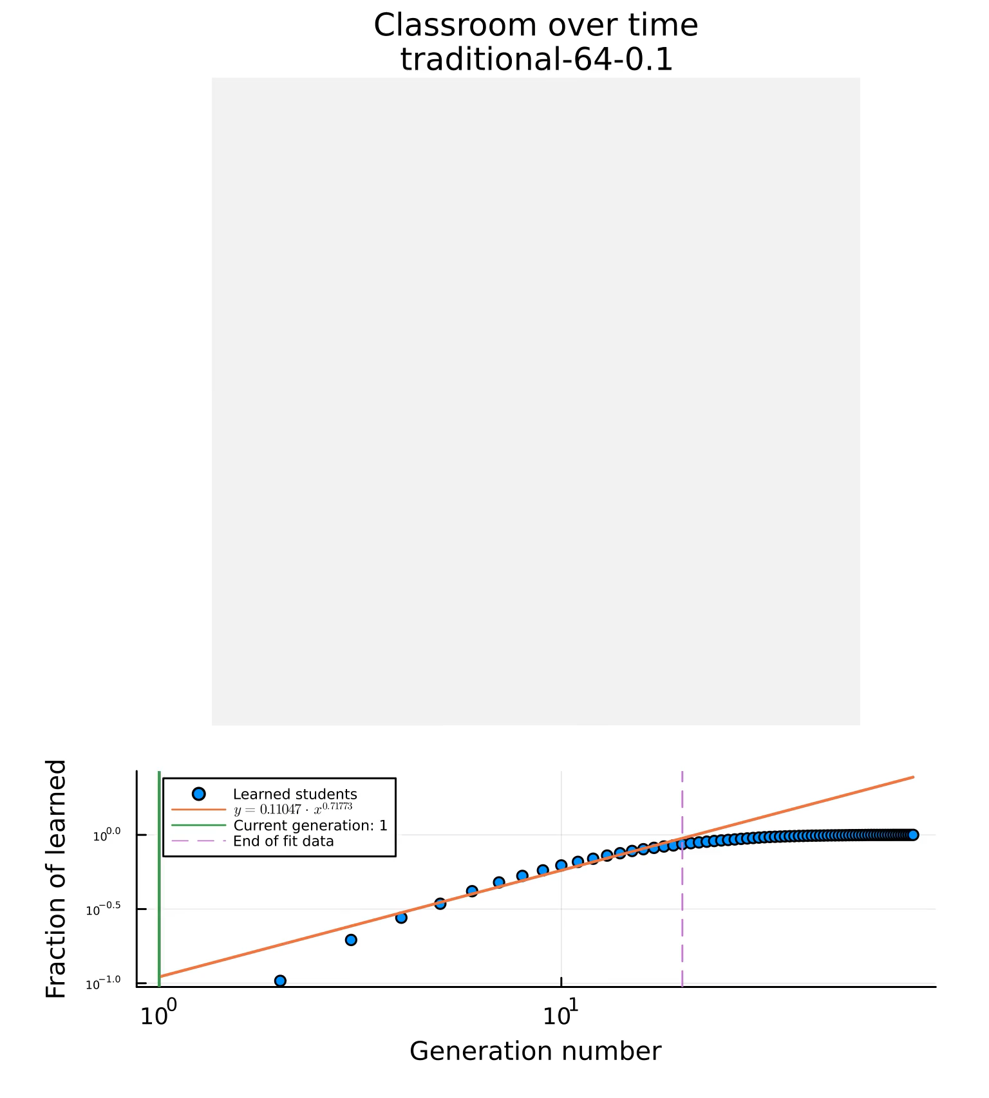
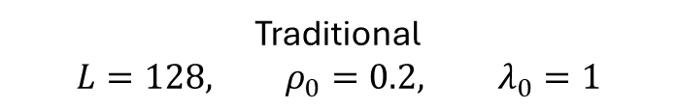
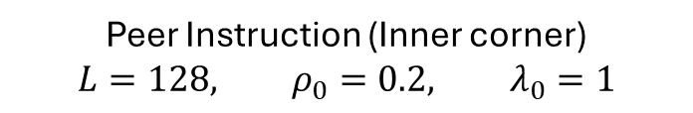
Progression of states for traditional and PI
Traditional
$$L=128, ρ_{0}=0.2, λ_{0}=1$$
Peer Instruction (Inner corner)
$$L=128, ρ_{0}=0.2, λ_{0}=1$$
Current time step:
Current time step:
Notes:
So side by side, they would look something like this. Traditional instruction being the one on the left side and peer instruction on the right.
Now that we have the simulations working, how would we then assess the performance of these methods of instruction?

Slide 21


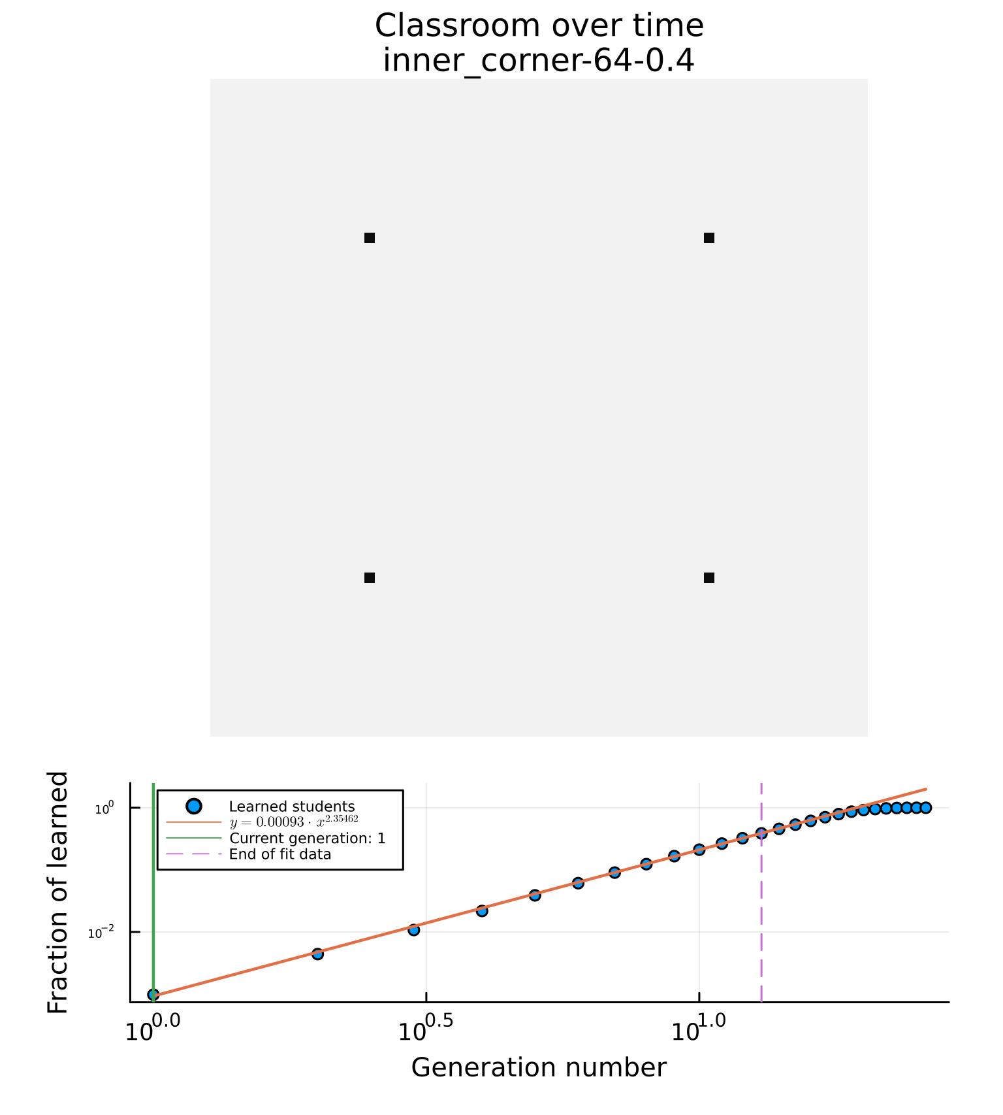
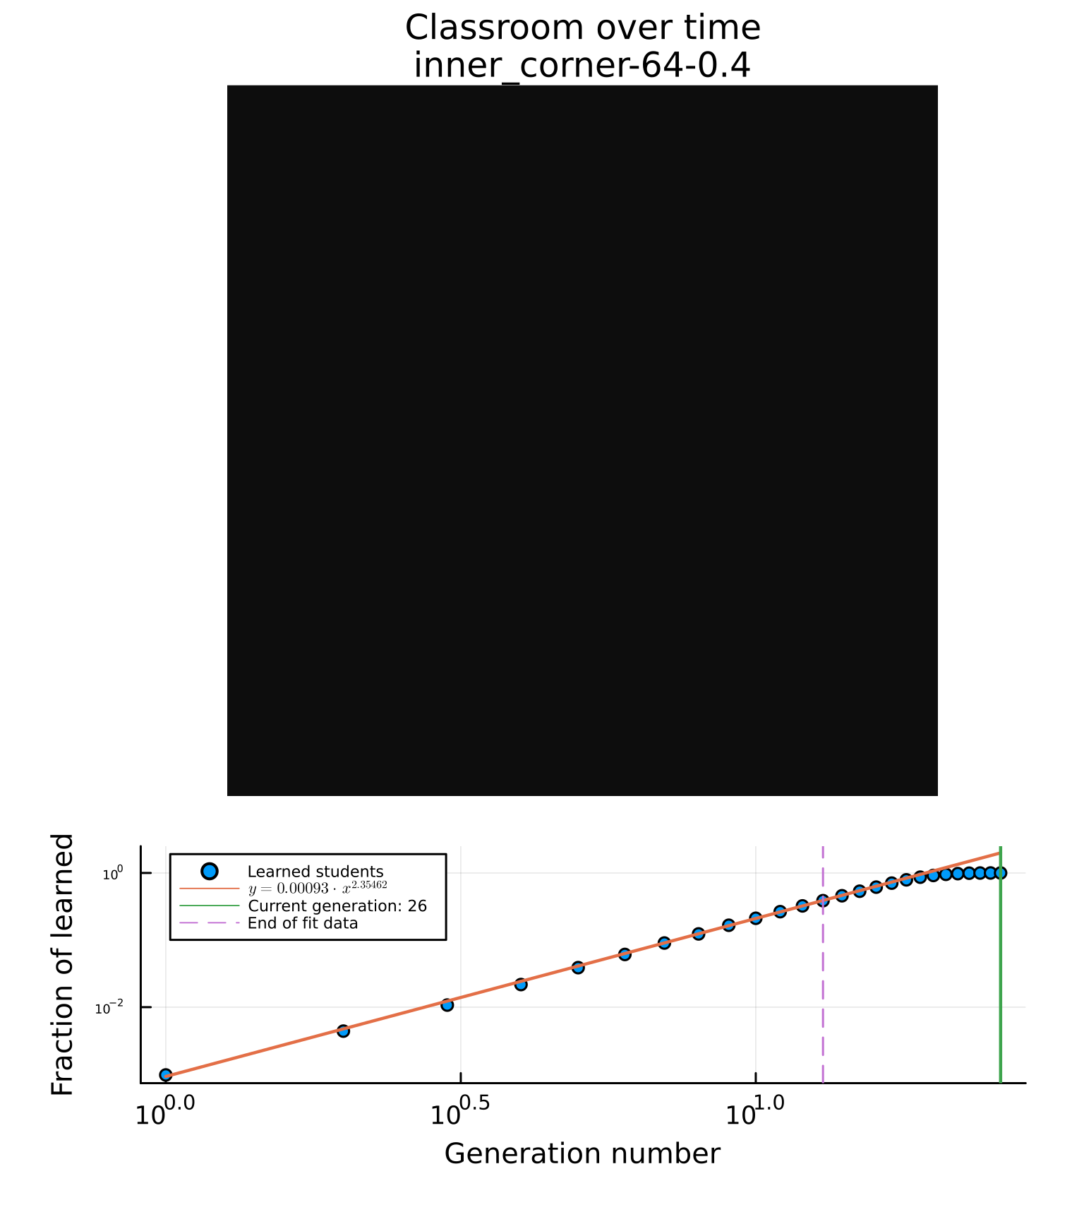

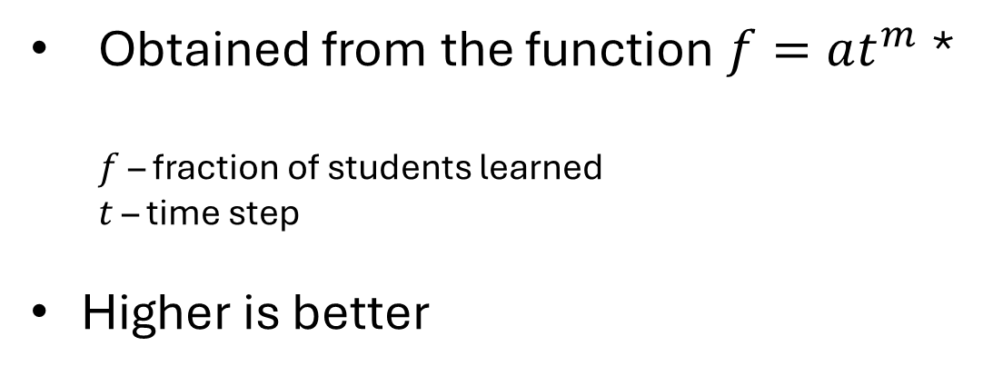
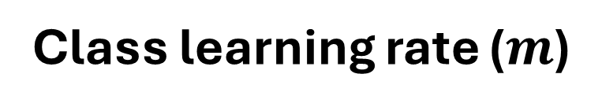
Performance parameters
Time to learn ($t_{max}$)
Class learning rate ($m$)
Time until all students are learned
Lower is better
Obtained from the function $f=at^{m}$ *
$f$ – fraction of students learned
$t$ – time step
Higher is better
Notes:
We introduce two performance parameters.
One is time to learn ($t_{max}$) which is simply measured by the number of time steps until all students in the class are learned.
The second is class learning rate m which describes the average initial rate of the class. This is obtained by fitting the fraction of learned students as a power law function of time steps.

Slide 22
Performance parameters from data
Notes:
So applying this to our simulations, we can identify the tmax and m from the bottom plots. The fitted power law is represented by the orange line. In obtaining the learning rate, we truncate the data we fit to a fraction of the total data points acquired, the first 25% for traditional instruction and the first 50% for peer instruction. This is an attempt to make sure that we get the average class learning rate before the finite size effect starts to affect our data. We can also obtain time to learn $t_{max}$ from just the number of data points present.
Now that we can obtain time to learn and class learning rate, we’d have to vary the different input parameters so that we can see how performance would vary with different sets of parameters.

Slide 23
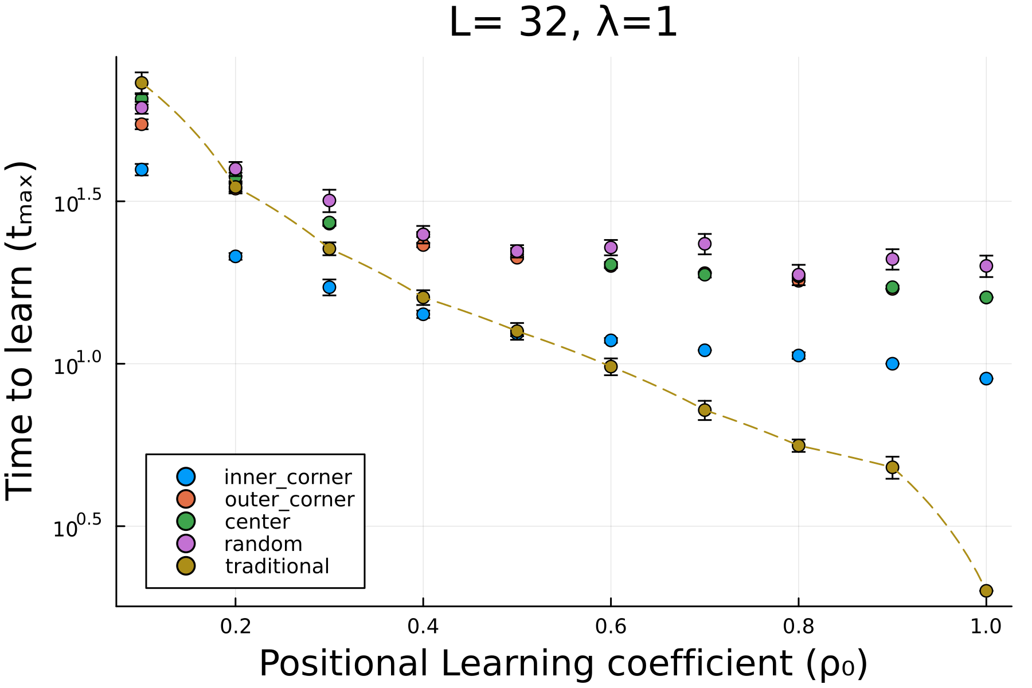
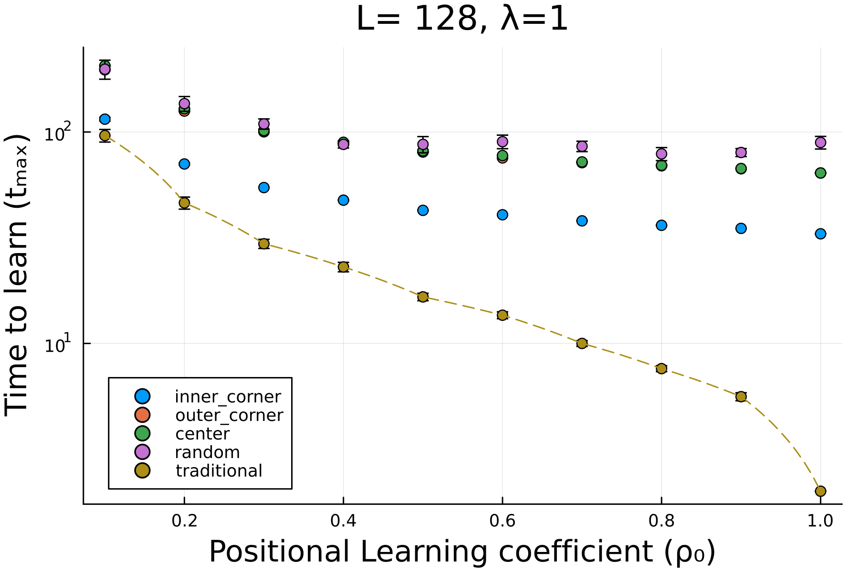
Inner corner performs the best for PI
Small class
Big class
*Lower is better
Notes:
These plots show how time to learn varies with different position learning coefficients $ρ_{0}$. Different colored data points correspond to different seating arrangements and methods of instruction with the gold points and dashed lines corresponding to traditional instruction.
These plots show how among the different seating arrangements that we considered, the inner corner performs the for peer instruction.
…

Slide 24
PI performs better for small slow class sizes
Small class
Big class
*Lower is better
Notes:
The second things we notice that in smaller classrooms with small learning coefficients $ρ_{0}$, the PI set-up can yield less time to learn compared to the traditional set up. In bigger classrooms, the traditional set ups are always better in terms of time to learn.

Slide 25
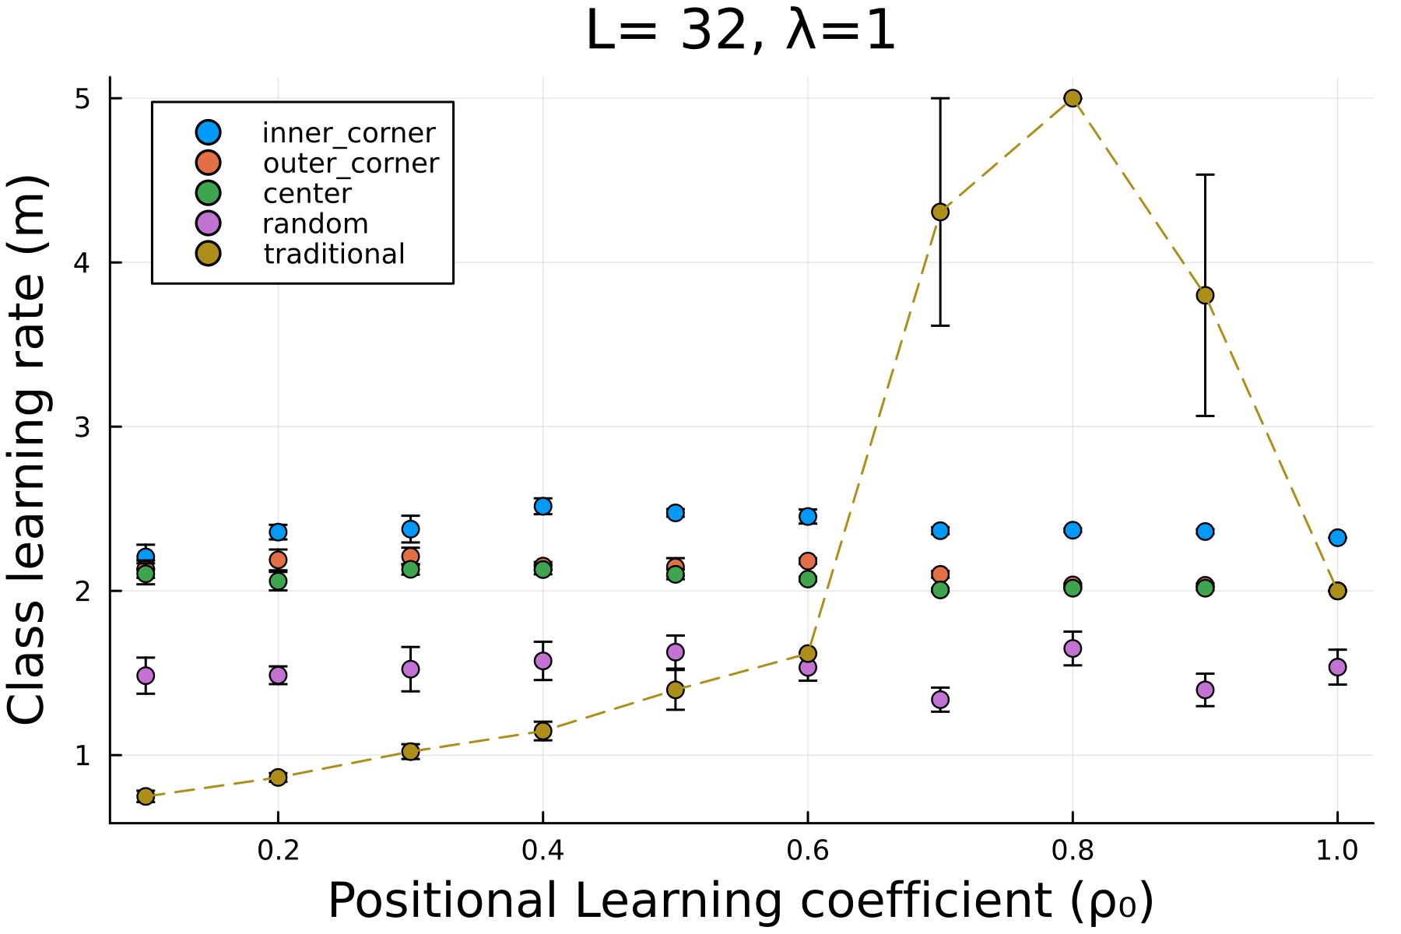
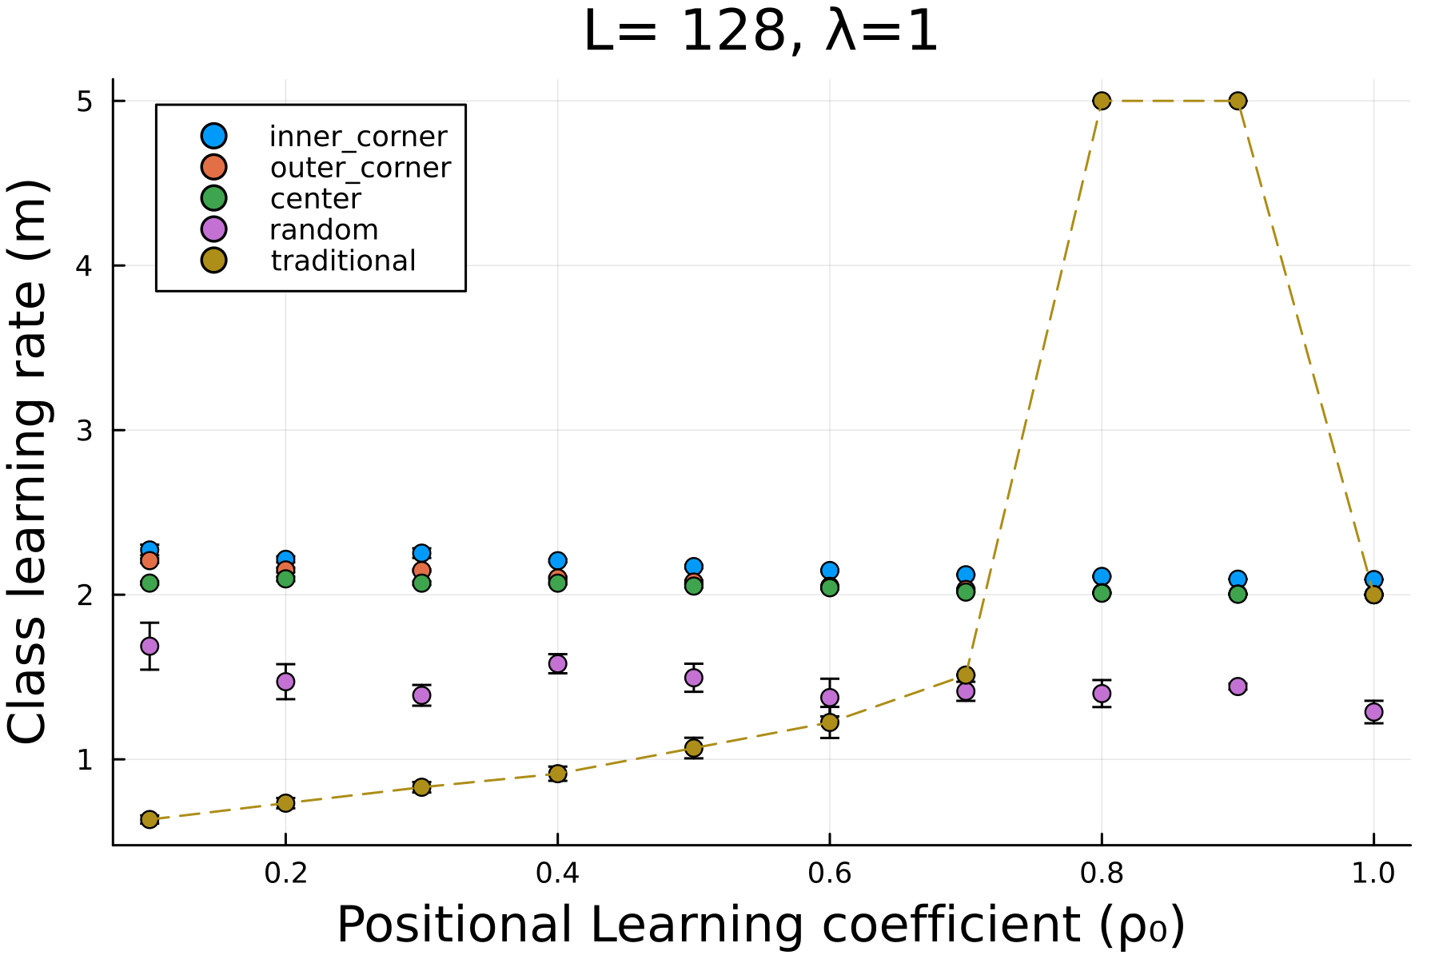
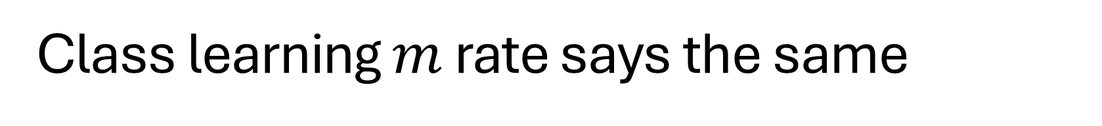
Class learning $m$ rate says the same
Small class
Big class
*Higher is better
Notes:
The same conclusions can be drawn when we plot how class learning rate m varies with positional learning coefficient $ρ_{0}.$ We see that class learning rate is highest for the inner corner seating arrangement among the ones we’ve considered. Class learning rate $m$ is higher for slower classes or those with low $ρ_{0}$ values. However, these plots don’t show the effect of class size since we only consider the average rate of learning.

Slide 26
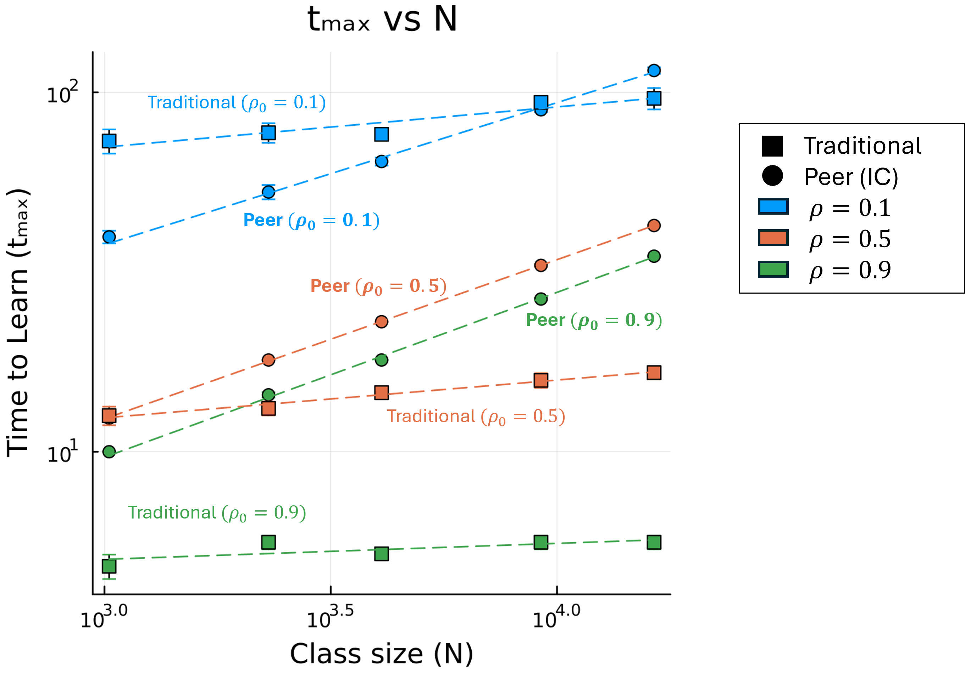
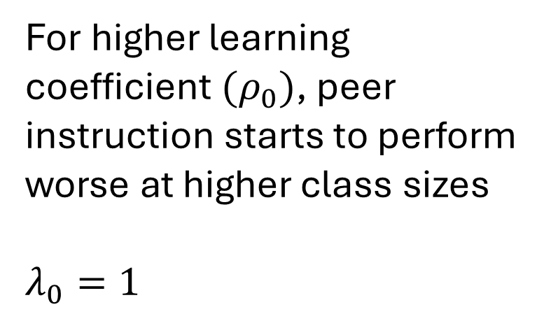
Traditional instruction does not scale with size
For higher learning coefficient $(ρ_{0})$, peer instruction starts to perform worse at higher class sizes
$λ_{0}=1$
*Lower is better
Notes:
When we vary class size, our previous observations on the effect of class size becomes more apparent.
This plot shows how time to learn $t_{max}$ varies with class size N. Each symbol represent a different class configuration – squares for the traditional set up and circles for the inner corner seating arrangement, representing peer instruction. Each color represents a different value of $ρ_{0}$
This shows us that peer instruction scales with class size while traditional instruction does not. This results is some lines crossing over. First considering the blue lines that represent low $ρ$ values, we see how peer instruction performs better for lower class sizes but once the class size exceeds 96^2, traditional instruction starts to perform better. On the other hand, considering the green lines that represent high $ρ$ values, we see that no matter the classroom size, traditional instruction always performs better then peer instruction.
All of our results so far only come from simulations where we considered learning rate to be homogenous across all the students, but this is too idealistic of an assumption.

Slide 27
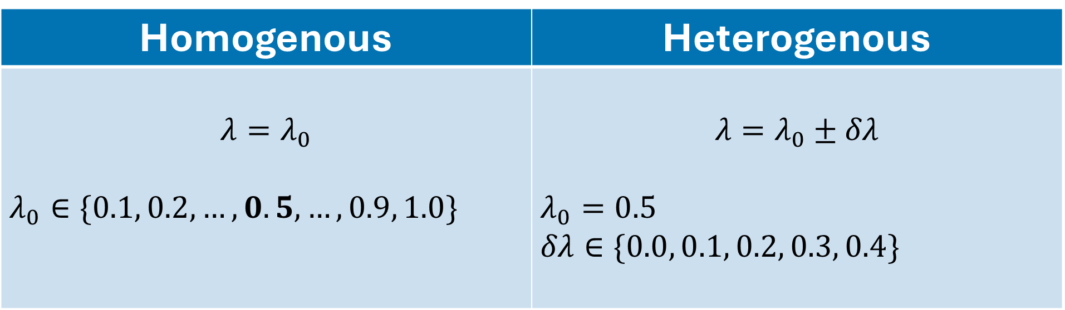
Homogenous vs heterogenous
Homogenous | Heterogenous
$$λ=λ_{0}$$ $λ_{0}∈\{0.1, 0.2, …,0.5,…, 0.9, 1.0\}$ | $$λ=λ_{0}±δλ$$ $λ_{0}=0.5$ $δλ∈\{0.0, 0.1, 0.2, 0.3, 0.4\}$
Notes:
To account for the differences among the students’ individual learning rate, we introduce a variable $δλ$ to describe the level of disparity or heterogeneity among the students’ learning rates. In this study, we only consider binary heterogeneity centered around $λ_{0}$. When assigning the two resulting values uniformly randomly to students, it keeps the average of all students’ learning rates 0.5. This is important so that we can compare it to the homogenous case where $λ_{0}$ is also 0.5

Slide 28
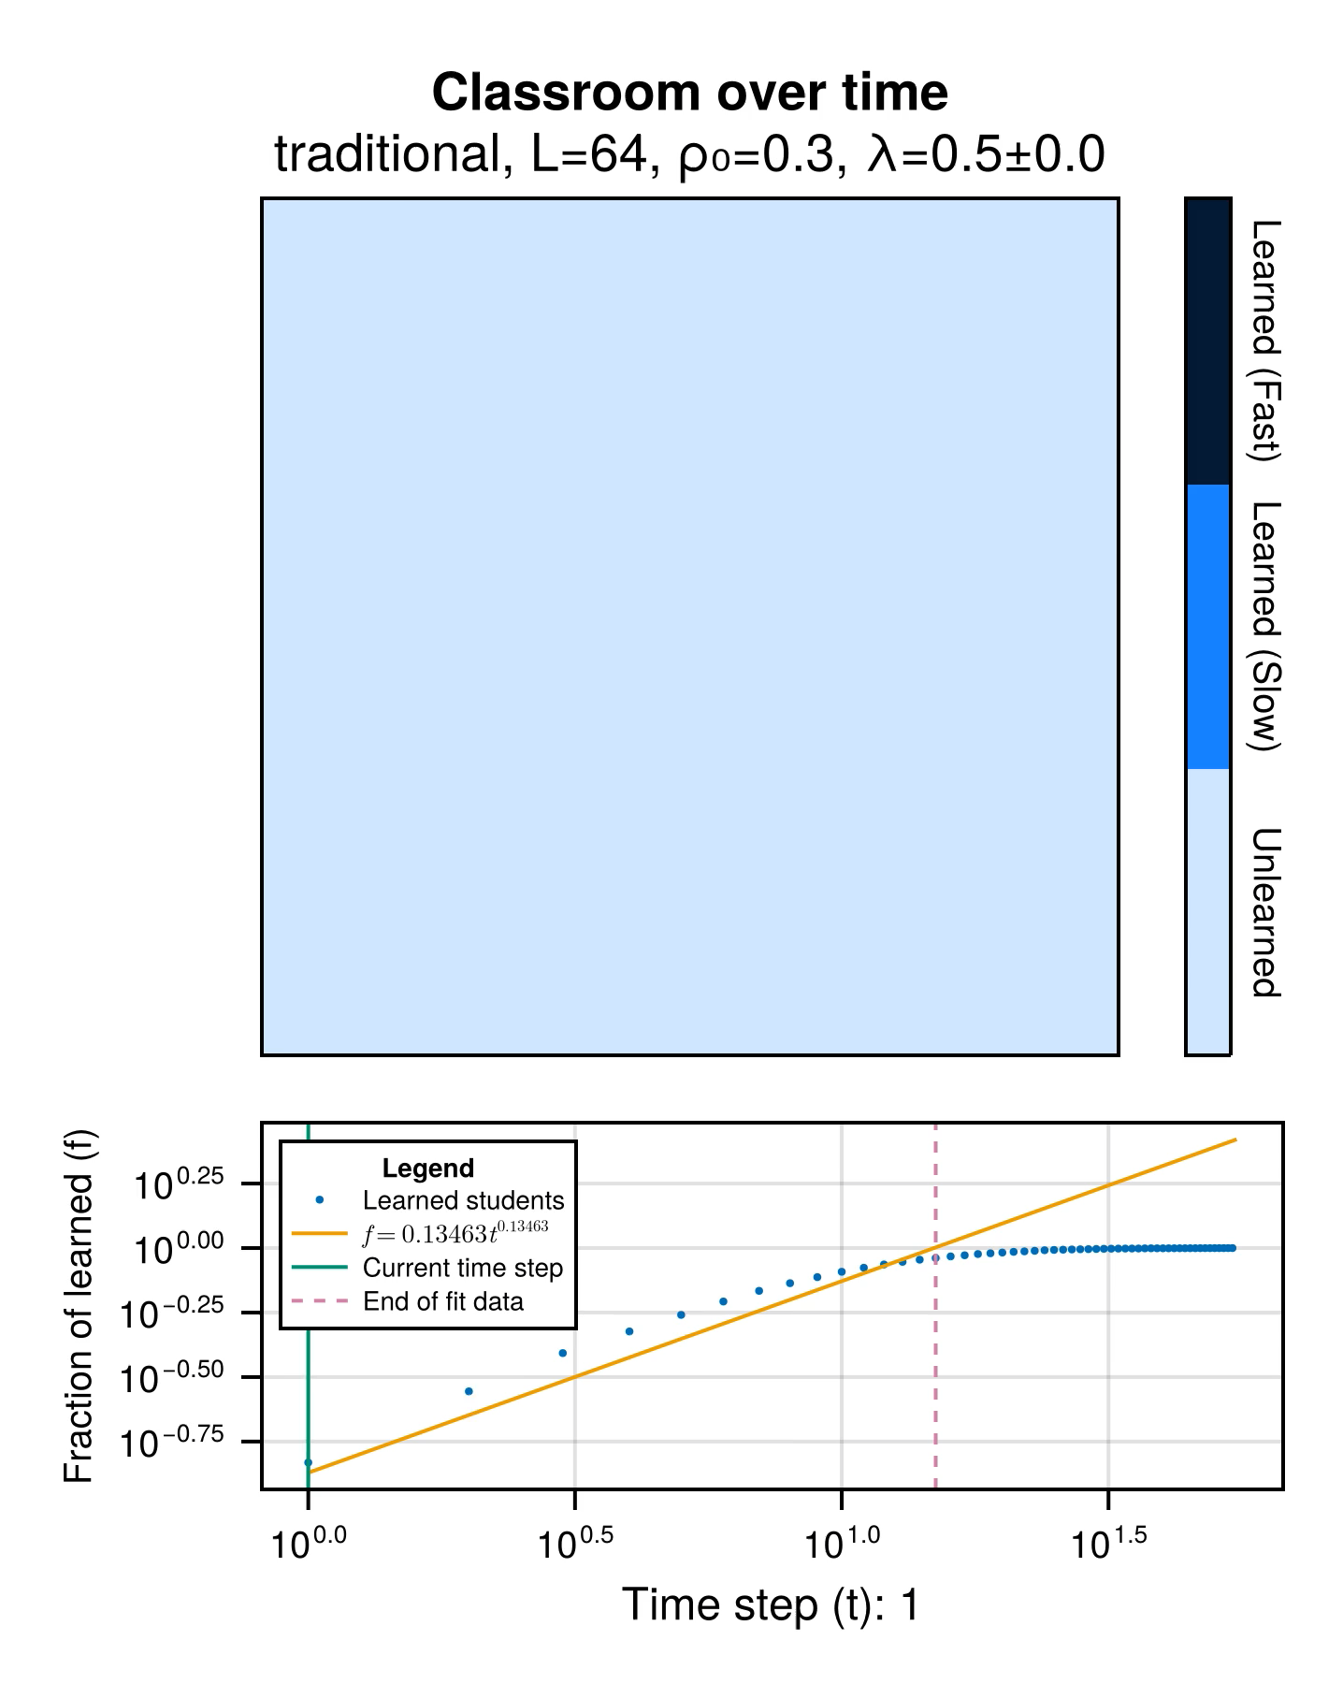
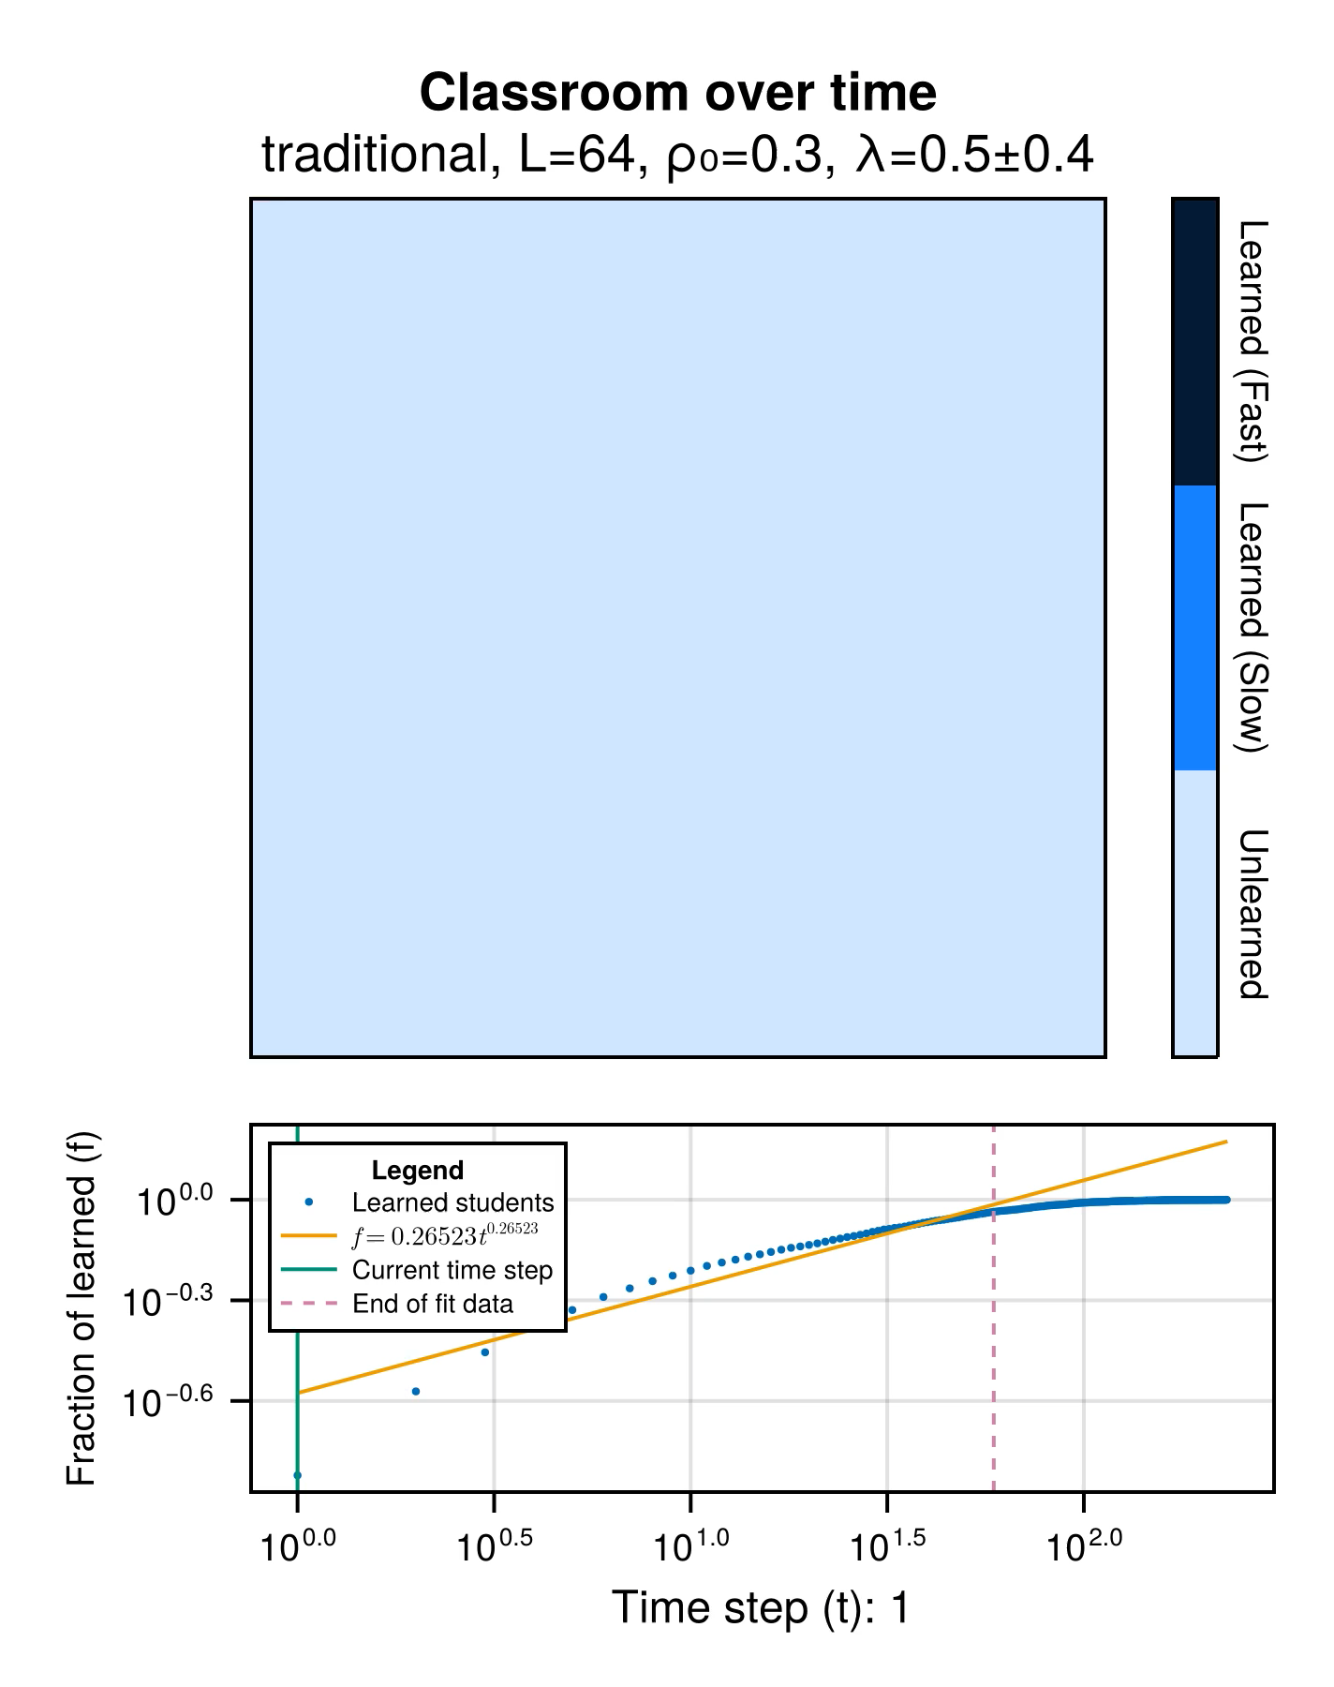
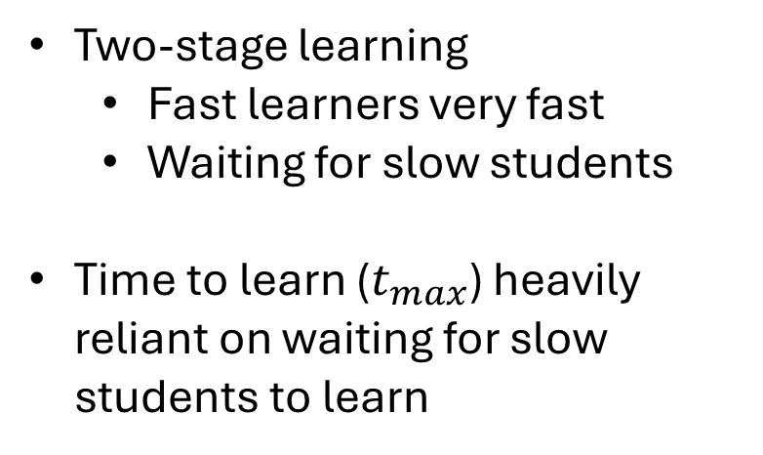
Two-stage learning dynamics for heterogenous traditional instruction
Homogenous
Heterogenous
Two-stage learning
Fast learners very fast
Waiting for slow students
Time to learn ($t_{max}$) heavily reliant on waiting for slow students to learn
Notes:
Once we introduce heterogeneity to the traditional instruction model, we notice a 2-stage learning dynamic where fast students very fast and majority of them learn in the first few time steps while the rest of the simulation time is only spent waiting for slow students to learn. Because of this, the time to learn $t_{max}$ for heterogenous traditional setups are heavily reliant on slow students.

Slide 29
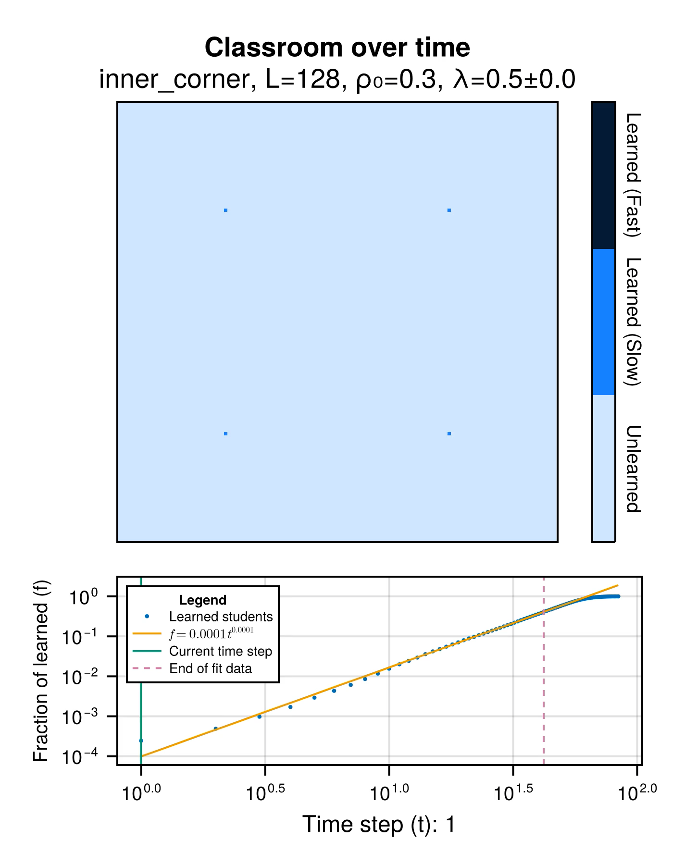
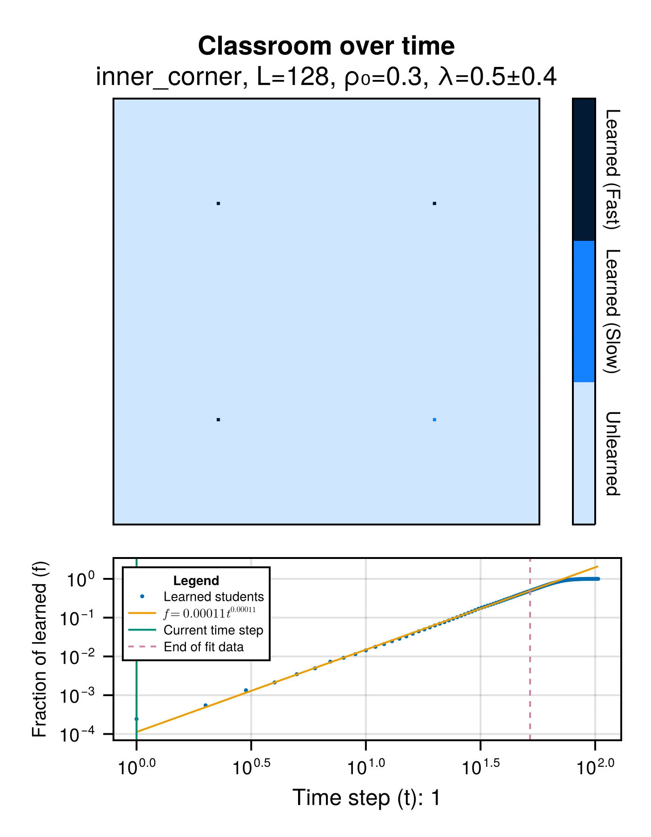
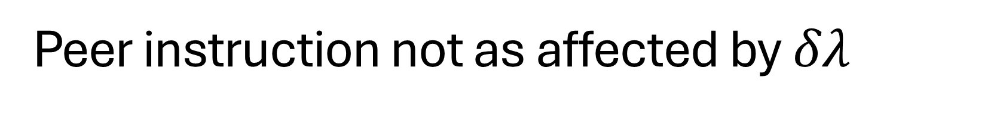
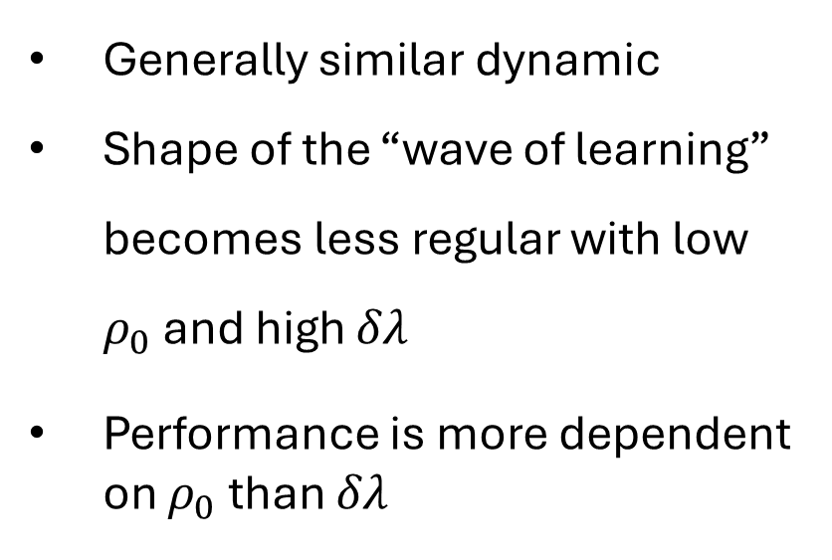
Peer instruction not as affected by $δλ$
Generally similar dynamic
Shape of the “wave of learning” becomes less regular with low $ρ_{0}$ and high $δλ$
Performance is more dependent on $ρ_{0}$ than $δλ$
Notes:
On the other hand, heterogeneity minimally impacts the dynamic of peer instruction. The biggest difference that we notice is that for high values of $δλ$ and low values $ρ_{0}$ the shape of the “wave of learning” becomes less circular compared to the homogenous peer instruction model. For peer instruction then, $ρ_{0}$ is still more impactful than $δλ$

Slide 30
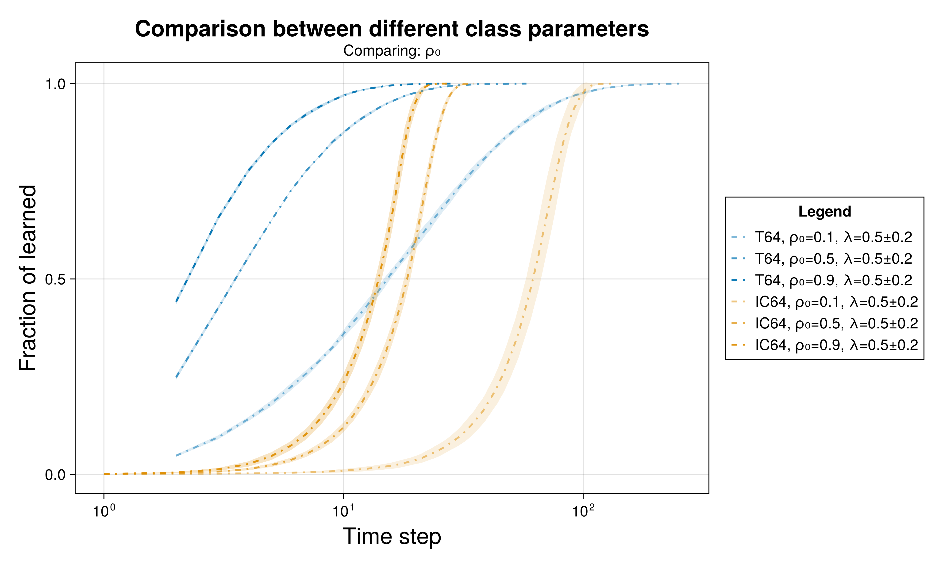
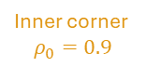
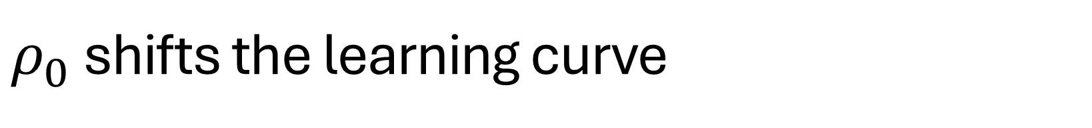





$ρ_{0}$ shifts the learning curve
Traditional
Changes initial average learning rate and initial number of learned students
Peer instruction
Horizontal shift
Traditional
$$ρ_{0}=0.9$$
Traditional
$$ρ_{0}=0.5$$
Traditional
$$ρ_{0}=0.1$$
Inner corner
$$ρ_{0}=0.1$$
Inner corner
$$ρ_{0}=0.9$$
Inner corner
$$ρ_{0}=0.5$$
$$L=64, λ=0.5±0.2$$
Notes:
Of course, we also want to compare how different values of $ρ_{0}$ changes how the class learns over time. This plot shows the average fraction of learned students as a function of time step for different values of $ρ_{0}$ for both traditional instruction and the inner corner seating arrangement as a representative of peer instruction. We see that for traditional instruction, a change in $ρ_{0}$ changes the initial average learning rate and the initial number of learned students, while for peer instruction, changes in $ρ_{0}$ values only shift the curve along the time step axis. This shows us that classes under traditional instruction has more students learning earlier compared to peer instruction.
---
Same end effect for both: delays how long it takes for all students to learn
For pi, needs patience, it takes time for the fast pick up of the class
For traditional, mas evident and gradual yung learning
Supports conclusion of traditional then PI

Slide 31







$δλ$ less impactful than $ρ_{0}$
Traditional
Minimal changes initial average learning rate
Peer instruction
Minimal horizontal shift
Traditional
$$δλ=0$$
Traditional
$$δλ=0.4$$
Traditional
$$δλ=0.2$$
Peer instruction
$$δλ=0.0, 0.2$$
Peer instruction
$$δλ=0.4$$
$$L=64, ρ_{0}=0.5, λ_{0}=0.5$$
Notes:
Following similar analysis but for heterogeneity $δλ$ shows us that traditional instruction more sensitive to heterogeneity compared to peer instruction. The effect of heterogeneity on traditional instruction is that it changes the initial average learning rate. While for peer instruction, it shifts the curves along the time step axis. Both of these effects happen with less magnitude compared to the effects of positional learning coefficient $ρ_{0}$. This lessened magnitude is even more noticeable for peer instruction where $δλ=0, 0.2$ basically have the same learning curve.
PI – does not affect PI that much
Traditional – similar effect to rho but does not change the initial value

Slide 32


Greater effect of heterogeneity on traditional instruction
*Lower is better
Notes:
Going back to using time to learn $t_{max}$ to gauge class performance. This graph shows $t_{max}$ as a function of $ρ_{0}$ where each band represents the range of $t_{max}$ values of each configuration with different values of heterogeneity $δλ$, and each color represents a different classroom configuration. We can observe that besides following a similar trend as the homogenous model, the bands for traditional instruction are much thicker than those for peer instruction meaning that traditional instruction is more sensitive to class heterogeneity than peer instruction – just as our previous observations have shown.

Slide 33

Greater effect of heterogeneity on traditional instruction
*Higher is better
Notes:
However, when we use class learning rate to measure class performance, we see a different story. The trends for the traditional model become really clean and straightforward – it even shows us that there are no intersections between the lines representing different $δλ$ values, meaning that across the different $ρ_{0}$ values we’ve considered, lower values of $δλ$ will always perform better. On the other hand, the learning rate for peer instruction becomes chaotic, with seemingly no trends and having large errors.

Slide 34



$δλ$’s minimal effect on PI $m$ values
*Higher is better
Notes:
Another possible reason is that it’s possible that there really that much of a difference for PI when varying heterogeneity. The major difference between these two plots is the scale of the y-axis. The left side graph has steps of 1, while the right side graph has steps of 0.1. Zooming out to the same scale would lead us to the same conclusions as with the homogenous model and previous investigations of the effects of heterogeneity. Heterogeneity does not impact peer instruction as much as traditional instruction.
Still, this is only a possible explanation and we still can’t rule out possible errors with methodology such as having a equal cut-off points for fitting in all simulations. Because of this, we’ve decided not to use class learning rate $m$ as a metric for class performance moving forward.

Slide 35














Heterogenous classes lends itself to PI even when classes are large
Homogenous $(δλ=0.0)$
Highly Heterogenous $(δλ=0.4)$
Traditional $(ρ_{0}=0.1)$
Traditional $(ρ_{0}=0.1)$
Peer $(ρ_{0}=0.1)$
Peer $(ρ_{0}=0.1)$
Peer $(ρ_{0}=0.5)$
Traditional $(ρ_{0}=0.5)$
Traditional $(ρ_{0}=0.9)$
Traditional $(ρ_{0}=0.5)$
Peer $(ρ_{0}=0.5)$
Peer $(ρ_{0}=0.9)$
Traditional $(ρ_{0}=0.9)$
Peer $(ρ_{0}=0.9)$
*Lower is better
Notes:
Just as we did for the homogenous model, we can investigate the effect of class size $N$ with time to learn $t_{max}$. The plot on the left show results for a homogenous case, while the plot on the right shows the results for a highly heterogenous case. For both plots, square symbols represent peer instruction’s inner corner seating arrangement and circles represent traditional instruction. Different colors also correspond to different $ρ_{0}$ values.
Here we can observe two effects stemming from heterogeneity:
First, traditional instruction shifts up compared to their peer instruction counterparts, even to the point where we no longer see the cross over points that we see in the homogenous case. This means that for highly heterogenous classrooms, regardless of class size, peer instruction will always perform better.
Second, that slopes for these lines become more uniform compared to the homogenous case. The slopes of traditional and peer instruction start to look the same, even despite the observed advantage of traditional instruction in its size invariability.

Slide 36



PI is a safe option
*Lower is better
Notes:
These plots give an overview of how our input parameters for the heterogenous case $L$, $ρ_{0}$, and $δλ$ affect $t_{max}$. The blue surface represents the inner corner SA as a representative of peer instruction, while the orange surface represents traditional instruction.
This confirms our previous findings that peer instruction is better for small, slow, and highly heterogenous classes. However, it also shows us how peer instruction can be a safe option if one has to decide between one method of instruction over the other. While traditional instruction can sometimes be advantageous over peer instruction, the difference between them in terms of time to learn $t_{max}$ is never that big. However in cases where peer instruction is advantageous, it could prove to be hugely advantageous – such is what we see in the corner of high $δλ$ and low $ρ_{0}$ values.

Slide 37

Summary and conclusions
Traditional instruction | Peer instruction
More sensitive to student learning rate heterogeneity More students learn earlier compared to PI Time to learn ($t_{max}$) dependent slow learners | Less affected by student learning rate heterogeneity Dependent on classroom geometry and initial conditions Inner corner SA performs best Lower initial class learning rate $m$ Generally lower time to learn $t_{max}$ Can be a safe option
Notes:
To conclude, we found that
Traditional instruction is more sensitive to variations in the students’ individual learning rate
Traditional instruction has more students learning earlier but takes more time to get all the students in class to learn
Peer instruction is not so dependent on students’ individual learning rate but is dependent on initial conditions and classroom geometry
Among the seating arrangements considered, the inner corner arrangement performed the best
Peer instruction has a lower class learning rate but takes less time to get all the students in the class to learn
Peer instruction proves to be a safe option when choosing only one method of instruction

Slide 38

Comparison with other research
Limitations | Differences | Similarities
Binary state agents No similarity effect (Smith, et. al., 2009) Isotropic learning | Class learning vs individual learning Optimal seating arrangements (Roxas et. al., 2010) | Peer $≥$ traditional (Crouch and Mazur, 2001; Lasry et. al., 2008) Both methods are more effective with homogenous classes (Roxas et. al., 2010)
Notes:
Of course, in the end, our model does not perfectly model reality. Our model only deals with binary state agents. Besides adding granularity, it also hinders us from implementing a similarity effect mentioned in some papers where students learn better when grouped together with others who have the same aptitude regardless of their actual aptitude. We also did not consider anisotropy in learning which could very well be something that happens in the classroom.
A few of the big differences we have when compared to other research are our choice of metrics and our findings on the optimal seating arrangements. Our focus in this research was on class learning instead of individual learning as many others have focused on and measured via pre-tests and post-tests. Our findings regarding the optimal SA actually differs from the findings of Dr. Roxas-Villanueva et. al. in their 2010 paper. We suspect this is because of the mentioned limitations, specifically the lack of implementation of the similarity effect.
But even with these limitations and differences, we were still able to arrive at the same conclusions as many other researches – that peer instruction can perform as good as or even better than traditional instruction, and that both methods are more effective with homogenous classes.

Slide 39
Classroom learning dynamics using a cellular automata spatiotemporal model comparing peer instruction and traditional instruction
Undergraduate Thesis Defense
National Institute of Physics
December 12, 2024, 10:30 AM
THANK YOU!!!
Clarence Ioakim T. Sy
BS Applied Physics
Instrumentation Physics Laboratory
National Institute of Physics
University of the Philippines Diliman
Adviser: Johnrob Y. Bantang, Ph.D.

Slide 40

Inner corner as the best PI seating arrangement

Slide 41

Size invariance of traditional instruction
Notes:
Left:
Size does not affect traditional
Delay ulit yung effect sa PI. Scales with size

Slide 42

Learning curves for different SAs
Notes:
Random: mixes both – least extreme of OC and C
IC: optimized
T: baseline

Slide 43


Heterogeneity effects are similar to size

